Slide 1
CRYPTOGRAPHY IN PYTHON

Slide 2
About The Instructor
from Budapest, Hungary
BSc in physics
MSc in applied mathematics
working as a software engineer
special addiction to algorithms, artificial intelligence and
quantitative finance

Slide 3
About The Course
cryptography fundamentals
Caesar cipher
Vigenere cipher
detecting language
frequency analysis
Kasiski-algorithm
Data Encryption Standard (DES)
Advanced Encryption Standard (AES)

Slide 4
About The Course
public key cryptosystems
modular arithmetic
Diffie-Hellman key exchange
RSA

Slide 5
HD Option For the Lectures

Slide 6
Cryptography
„Cryptography is the practise and study of techniques for secure
communication in the presence of third parties”
The basic concept is that there are cases when we want to make sure a given message
is read by the sender and the receiver exclusively
→ during World War II (allies vs. germans)
→ tranfering funds electronically
→ cryptocurrency and blockchain
→ storing users’ information in a database (credit card passwords)

Slide 7
Cryptography
„Cryptography is the practise and study of techniques for secure
communication in the presence of third parties”
PLAINTEXT: the message itself we want to encrypt
CIPHERTEXT: the encrypted message
ENCRYPTION: the process of encoding a given message in a way
that only the authorized parties can access it
DECRYPTION: process of decoding a given message
KEY: this is a sequence that is needed both for encryption and decryption

Slide 8
Cryptography
„Cryptography is the practise and study of techniques for secure
communication in the presence of third parties”
PLAINTEXT
CIPHERTEXT
CIPHERTEXT
PLAINTEXT
KEY
KEY
plain_text = f (cipher_text, key) decryption function
cipher_text = f(plain_text, key) encryption function
-1

Slide 9
Cryptography
PRIVATE KEY CRYPTOGRAPHY
This type of cryptography uses just a single key. So the same key is used
both for encryption and decryption as well
~ this is why it is also called „symmetric encryption”
THE MAIN PROBLEM IS THAT THE KEY MUST BE EXCHANGED !!!
PLAINTEXT
CIPHERTEXT
PLAINTEXT
KEY
KEY
For example: Caesar-cipher, DES and AES

Slide 10
Cryptography
PUBLIC KEY CRYPTOGRAPHY
This type of cryptography uses a public key and a private key as well.
~ this is why it is also called „asymmetric encryption”
→ we should keep the private key secret
→ if Alice wants to send a message to Bob then Alice will encrypt it with
Bob’s public key and Bob can decrypt the message with its private key
PLAINTEXT
CIPHERTEXT
PLAINTEXT
PUBLIC
KEY
PRIVATE
KEY
THE PRIVATE KEY NEVER NEEDS TO BE EXCHANGED !!!
For example: RSA or Elliptic Curve Cryptography

Slide 11
Caesar-cipher
it is a private key encryption (symmetric encryption) method
it was first used by Julius Caesar ~2000 years ago
it is a type of substitution cipher: we shift every single letter in the plaintext
with a fixed number of letters
THE KEY ITSELF IS THE NUMBER OF LETTERS WE USE FOR SHIFTING
First we assign numerical values to every letter in the alphabet to be able to
use mathematical operations during encryption/decryption
A B C D E F G H I J K L M N O P Q R S T U V W X Y Z
0
1
2
3
4
5
6
7
8
9
10
11
12
13
14
15
16
17
18
19
20
21
22
23
24
25

Slide 12
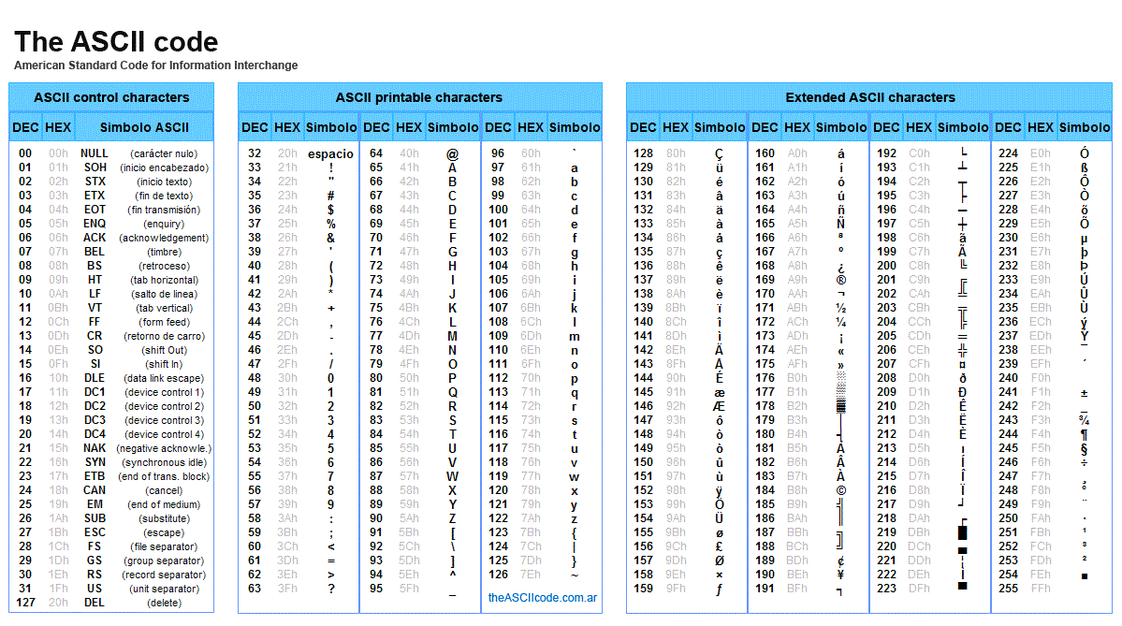
Caesar-cipher

Slide 13
Caesar-cipher
ENCRYPTION
E (x) = (x+n) mod 26
n
we have to consider all the characters in the plaintext
E(x) is the encrypted letter of the original x letter
we have to shift the given letter with n (where n is the key)
Why to use mod 26? The size of the english alphabet is 26 which means
there are 26 letters in the english alphabet
~ we want to make sure the encrypted letter is within
the range [0,SIZE_ALPHABET-1] so this is why to use mod 26

Slide 14
Caesar-cipher
DECRYPTION
E (x) = (x-n) mod 26
n
we have to consider all the characters in the ciphertext
D(x) is the decrypted letter (x is the letter in the ciphertext)
we have to shift the given letter with -n (where n is the key)
Why to use mod 26? The size of the english alphabet is 26 which means
there are 26 letters in the english alphabet
~ we want to make sure the encrypted letter is within
the range [0,SIZE_ALPHABET-1] so this is why to use mod 26

Slide 15
Caesar-cipher
A B C D E F G H I J K L M N O P Q R S T U V W X Y Z
EXAMPLE
PRIVATE KEY = 3
0
1
2
3
4
5
6
7
8
9
10
11
12
13
14
15
16
17
18
19
20
21
22
23
24
25
E (x) = (x+n) mod 26
n

Slide 16
Caesar-cipher
A B C D E F G H I J K L M N O P Q R S T U V W X Y Z
EXAMPLE
PRIVATE KEY = 3
0
1
2
3
4
5
6
7
8
9
10
11
12
13
14
15
16
17
18
19
20
21
22
23
24
25
Plaintext: THIS IS AN EXAMPLE
Ciphertext:
E (x) = (x+n) mod 26
n

Slide 17
Caesar-cipher
A B C D E F G H I J K L M N O P Q R S T U V W X Y Z
EXAMPLE
PRIVATE KEY = 3
0
1
2
3
4
5
6
7
8
9
10
11
12
13
14
15
16
17
18
19
20
21
22
23
24
25
Plaintext: THIS IS AN EXAMPLE
Ciphertext: W
E (x) = (x+n) mod 26
n

Slide 18
Caesar-cipher
A B C D E F G H I J K L M N O P Q R S T U V W X Y Z
EXAMPLE
PRIVATE KEY = 3
0
1
2
3
4
5
6
7
8
9
10
11
12
13
14
15
16
17
18
19
20
21
22
23
24
25
Plaintext: THIS IS AN EXAMPLE
Ciphertext: WK
E (x) = (x+n) mod 26
n

Slide 19
Caesar-cipher
A B C D E F G H I J K L M N O P Q R S T U V W X Y Z
EXAMPLE
PRIVATE KEY = 3
0
1
2
3
4
5
6
7
8
9
10
11
12
13
14
15
16
17
18
19
20
21
22
23
24
25
Plaintext: THIS IS AN EXAMPLE
Ciphertext: WKL
E (x) = (x+n) mod 26
n

Slide 20
Caesar-cipher
A B C D E F G H I J K L M N O P Q R S T U V W X Y Z
EXAMPLE
PRIVATE KEY = 3
0
1
2
3
4
5
6
7
8
9
10
11
12
13
14
15
16
17
18
19
20
21
22
23
24
25
Plaintext: THIS IS AN EXAMPLE
Ciphertext: WKLV
E (x) = (x+n) mod 26
n

Slide 21
Caesar-cipher
A B C D E F G H I J K L M N O P Q R S T U V W X Y Z
EXAMPLE
PRIVATE KEY = 3
0
1
2
3
4
5
6
7
8
9
10
11
12
13
14
15
16
17
18
19
20
21
22
23
24
25
Plaintext: THIS IS AN EXAMPLE
Ciphertext: WKLV L
E (x) = (x+n) mod 26
n

Slide 22
Caesar-cipher
A B C D E F G H I J K L M N O P Q R S T U V W X Y Z
EXAMPLE
PRIVATE KEY = 3
0
1
2
3
4
5
6
7
8
9
10
11
12
13
14
15
16
17
18
19
20
21
22
23
24
25
Plaintext: THIS IS AN EXAMPLE
Ciphertext: WKLV LV
E (x) = (x+n) mod 26
n

Slide 23
Caesar-cipher
A B C D E F G H I J K L M N O P Q R S T U V W X Y Z
EXAMPLE
PRIVATE KEY = 3
0
1
2
3
4
5
6
7
8
9
10
11
12
13
14
15
16
17
18
19
20
21
22
23
24
25
Plaintext: THIS IS AN EXAMPLE
Ciphertext: WKLV LV D
E (x) = (x+n) mod 26
n

Slide 24
Caesar-cipher
A B C D E F G H I J K L M N O P Q R S T U V W X Y Z
EXAMPLE
PRIVATE KEY = 3
0
1
2
3
4
5
6
7
8
9
10
11
12
13
14
15
16
17
18
19
20
21
22
23
24
25
Plaintext: THIS IS AN EXAMPLE
Ciphertext: WKLV LV DQ
E (x) = (x+n) mod 26
n

Slide 25
Caesar-cipher
A B C D E F G H I J K L M N O P Q R S T U V W X Y Z
EXAMPLE
PRIVATE KEY = 3
0
1
2
3
4
5
6
7
8
9
10
11
12
13
14
15
16
17
18
19
20
21
22
23
24
25
Plaintext: THIS IS AN EXAMPLE
Ciphertext: WKLV LV DQ H
E (x) = (x+n) mod 26
n

Slide 26
Caesar-cipher
A B C D E F G H I J K L M N O P Q R S T U V W X Y Z
EXAMPLE
PRIVATE KEY = 3
0
1
2
3
4
5
6
7
8
9
10
11
12
13
14
15
16
17
18
19
20
21
22
23
24
25
Plaintext: THIS IS AN EXAMPLE
Ciphertext: WKLV LV DQ HA
E (x) = (x+n) mod 26
n

Slide 27
Caesar-cipher
A B C D E F G H I J K L M N O P Q R S T U V W X Y Z
EXAMPLE
PRIVATE KEY = 3
0
1
2
3
4
5
6
7
8
9
10
11
12
13
14
15
16
17
18
19
20
21
22
23
24
25
Plaintext: THIS IS AN EXAMPLE
Ciphertext: WKLV LV DQ HAD
E (x) = (x+n) mod 26
n

Slide 28
Caesar-cipher
A B C D E F G H I J K L M N O P Q R S T U V W X Y Z
EXAMPLE
PRIVATE KEY = 3
0
1
2
3
4
5
6
7
8
9
10
11
12
13
14
15
16
17
18
19
20
21
22
23
24
25
Plaintext: THIS IS AN EXAMPLE
Ciphertext: WKLV LV DQ HADP
E (x) = (x+n) mod 26
n

Slide 29
Caesar-cipher
A B C D E F G H I J K L M N O P Q R S T U V W X Y Z
EXAMPLE
PRIVATE KEY = 3
0
1
2
3
4
5
6
7
8
9
10
11
12
13
14
15
16
17
18
19
20
21
22
23
24
25
Plaintext: THIS IS AN EXAMPLE
Ciphertext: WKLV LV DQ HADPS
E (x) = (x+n) mod 26
n

Slide 30
Caesar-cipher
A B C D E F G H I J K L M N O P Q R S T U V W X Y Z
EXAMPLE
PRIVATE KEY = 3
0
1
2
3
4
5
6
7
8
9
10
11
12
13
14
15
16
17
18
19
20
21
22
23
24
25
Plaintext: THIS IS AN EXAMPLE
Ciphertext: WKLV LV DQ HADPSO
E (x) = (x+n) mod 26
n

Slide 31
Caesar-cipher
A B C D E F G H I J K L M N O P Q R S T U V W X Y Z
EXAMPLE
PRIVATE KEY = 3
0
1
2
3
4
5
6
7
8
9
10
11
12
13
14
15
16
17
18
19
20
21
22
23
24
25
Plaintext: THIS IS AN EXAMPLE
Ciphertext: WKLV LV DQ HADPSOH
E (x) = (x+n) mod 26
n

Slide 32
Caesar-cipher
A B C D E F G H I J K L M N O P Q R S T U V W X Y Z
EXAMPLE
PRIVATE KEY = 3
0
1
2
3
4
5
6
7
8
9
10
11
12
13
14
15
16
17
18
19
20
21
22
23
24
25
Plaintext: THIS IS AN EXAMPLE
Ciphertext: WKLV LV DQ HADPSOH
E (x) = (x+n) mod 26
n

Slide 33
Caesar-cipher
A B C D E F G H I J K L M N O P Q R S T U V W X Y Z
EXAMPLE
PRIVATE KEY = 3
0
1
2
3
4
5
6
7
8
9
10
11
12
13
14
15
16
17
18
19
20
21
22
23
24
25
Plaintext:
Ciphertext: WKLV LV DQ HADPSOH
D (x) = (x-n) mod 26
n

Slide 34
Caesar-cipher
A B C D E F G H I J K L M N O P Q R S T U V W X Y Z
EXAMPLE
PRIVATE KEY = 3
0
1
2
3
4
5
6
7
8
9
10
11
12
13
14
15
16
17
18
19
20
21
22
23
24
25
Plaintext: T
Ciphertext: WKLV LV DQ HADPSOH
D (x) = (x-n) mod 26
n

Slide 35
Caesar-cipher
A B C D E F G H I J K L M N O P Q R S T U V W X Y Z
EXAMPLE
PRIVATE KEY = 3
0
1
2
3
4
5
6
7
8
9
10
11
12
13
14
15
16
17
18
19
20
21
22
23
24
25
Plaintext: TH
Ciphertext: WKLV LV DQ HADPSOH
D (x) = (x-n) mod 26
n

Slide 36
Caesar-cipher
A B C D E F G H I J K L M N O P Q R S T U V W X Y Z
EXAMPLE
PRIVATE KEY = 3
0
1
2
3
4
5
6
7
8
9
10
11
12
13
14
15
16
17
18
19
20
21
22
23
24
25
Plaintext: THI
Ciphertext: WKLV LV DQ HADPSOH
D (x) = (x-n) mod 26
n

Slide 37
Caesar-cipher
A B C D E F G H I J K L M N O P Q R S T U V W X Y Z
EXAMPLE
PRIVATE KEY = 3
0
1
2
3
4
5
6
7
8
9
10
11
12
13
14
15
16
17
18
19
20
21
22
23
24
25
Plaintext: THIS
Ciphertext: WKLV LV DQ HADPSOH
D (x) = (x-n) mod 26
n

Slide 38
Caesar-cipher
A B C D E F G H I J K L M N O P Q R S T U V W X Y Z
EXAMPLE
PRIVATE KEY = 3
0
1
2
3
4
5
6
7
8
9
10
11
12
13
14
15
16
17
18
19
20
21
22
23
24
25
Plaintext: THIS I
Ciphertext: WKLV LV DQ HADPSOH
D (x) = (x-n) mod 26
n

Slide 39
Caesar-cipher
A B C D E F G H I J K L M N O P Q R S T U V W X Y Z
EXAMPLE
PRIVATE KEY = 3
0
1
2
3
4
5
6
7
8
9
10
11
12
13
14
15
16
17
18
19
20
21
22
23
24
25
Plaintext: THIS IS
Ciphertext: WKLV LV DQ HADPSOH
D (x) = (x-n) mod 26
n

Slide 40
Caesar-cipher
A B C D E F G H I J K L M N O P Q R S T U V W X Y Z
EXAMPLE
PRIVATE KEY = 3
0
1
2
3
4
5
6
7
8
9
10
11
12
13
14
15
16
17
18
19
20
21
22
23
24
25
Plaintext: THIS IS A
Ciphertext: WKLV LV DQ HADPSOH
D (x) = (x-n) mod 26
n

Slide 41
Caesar-cipher
A B C D E F G H I J K L M N O P Q R S T U V W X Y Z
EXAMPLE
PRIVATE KEY = 3
0
1
2
3
4
5
6
7
8
9
10
11
12
13
14
15
16
17
18
19
20
21
22
23
24
25
Plaintext: THIS IS AN
Ciphertext: WKLV LV DQ HADPSOH
D (x) = (x-n) mod 26
n

Slide 42
Caesar-cipher
A B C D E F G H I J K L M N O P Q R S T U V W X Y Z
EXAMPLE
PRIVATE KEY = 3
0
1
2
3
4
5
6
7
8
9
10
11
12
13
14
15
16
17
18
19
20
21
22
23
24
25
Plaintext: THIS IS AN E
Ciphertext: WKLV LV DQ HADPSOH
D (x) = (x-n) mod 26
n

Slide 43
Caesar-cipher
A B C D E F G H I J K L M N O P Q R S T U V W X Y Z
EXAMPLE
PRIVATE KEY = 3
0
1
2
3
4
5
6
7
8
9
10
11
12
13
14
15
16
17
18
19
20
21
22
23
24
25
Plaintext: THIS IS AN EX
Ciphertext: WKLV LV DQ HADPSOH
D (x) = (x-n) mod 26
n

Slide 44
Caesar-cipher
A B C D E F G H I J K L M N O P Q R S T U V W X Y Z
EXAMPLE
PRIVATE KEY = 3
0
1
2
3
4
5
6
7
8
9
10
11
12
13
14
15
16
17
18
19
20
21
22
23
24
25
Plaintext: THIS IS AN EXA
Ciphertext: WKLV LV DQ HADPSOH
D (x) = (x-n) mod 26
n

Slide 45
Caesar-cipher
A B C D E F G H I J K L M N O P Q R S T U V W X Y Z
EXAMPLE
PRIVATE KEY = 3
0
1
2
3
4
5
6
7
8
9
10
11
12
13
14
15
16
17
18
19
20
21
22
23
24
25
Plaintext: THIS IS AN EXAM
Ciphertext: WKLV LV DQ HADPSOH
D (x) = (x-n) mod 26
n

Slide 46
Caesar-cipher
A B C D E F G H I J K L M N O P Q R S T U V W X Y Z
EXAMPLE
PRIVATE KEY = 3
0
1
2
3
4
5
6
7
8
9
10
11
12
13
14
15
16
17
18
19
20
21
22
23
24
25
Plaintext: THIS IS AN EXAMP
Ciphertext: WKLV LV DQ HADPSOH
D (x) = (x-n) mod 26
n

Slide 47
Caesar-cipher
A B C D E F G H I J K L M N O P Q R S T U V W X Y Z
EXAMPLE
PRIVATE KEY = 3
0
1
2
3
4
5
6
7
8
9
10
11
12
13
14
15
16
17
18
19
20
21
22
23
24
25
Plaintext: THIS IS AN EXAMPL
Ciphertext: WKLV LV DQ HADPSOH
D (x) = (x-n) mod 26
n

Slide 48
Caesar-cipher
A B C D E F G H I J K L M N O P Q R S T U V W X Y Z
EXAMPLE
PRIVATE KEY = 3
0
1
2
3
4
5
6
7
8
9
10
11
12
13
14
15
16
17
18
19
20
21
22
23
24
25
Plaintext: THIS IS AN EXAMPLE
Ciphertext: WKLV LV DQ HADPSOH
D (x) = (x-n) mod 26
n

Slide 49
Caesar-cipher
A B C D E F G H I J K L M N O P Q R S T U V W X Y Z
EXAMPLE
PRIVATE KEY = 3
0
1
2
3
4
5
6
7
8
9
10
11
12
13
14
15
16
17
18
19
20
21
22
23
24
25
Plaintext: THIS IS AN EXAMPLE
Ciphertext: WKLV LV DQ HADPSOH
D (x) = (x-n) mod 26
n

Slide 50
Cracking Caesar-cipher
The main problem with Caesar-cipher is that there are few possible key values
~ the keyspace is small: it contains 26 keys only !!!
NUMBER OF KEYS = SIZE OF THE ALPHABET
→ there are 26 letters in the alphabet so the number
of possible keys is 26 as well
→ intuition: let’s use Caesar-encryption several times (brute-force approach)
CAESAR CIPHER WILL NOT BE MORE SECURE IF WE REPEAT THE OPERATION
For example: using Caesar-encyrpion with key 2 and then with key 3
is the same as using key 5

Slide 51
Cracking Caesar-cipher
There are 2 types of approaches to crack Caesar-cipher:
1.) brute-force attack: because the number of possible key is 26 thats why
we can consider all these cases (so check all the possible key values)
→ we use all the possible key values within the range [0,SIZE_ALPHABET-1]
and check whether the decrypted message makes sense or not
~ it may be important to be able to detect english language
2.) frequency-analysis: we can analyse the frequency distribution of the letters
For example in an english language text some letters are more
frequent than others (E, A, O, I and T)
→ we can analyse the ciphertext and based on the most frequent letter
in the cipertext we can predict the key (so the number of shifts)
SHIFTING ALL LETTERS WITH THE SAME KEY
DOES NOT ALTER THE
DISTRIBUTION !!!

Slide 52
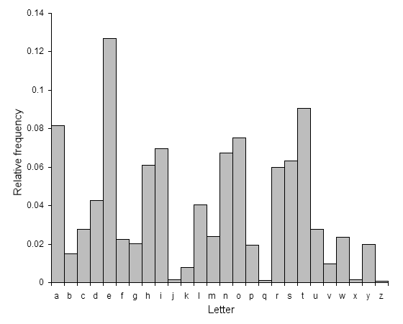
Cracking Caesar-cipher
So this is the relative frequency distribution of
letters in an english text
Frequency analysis cracking:
1.) calculate the relative frequency
distribution of the ciphertext’s letters
2.) get the most frequent letter in the ciphertext
(or the second because the most
frequent one may be white-spaces)
3.) we can get the key based on a simple formula
key = value of ciphertext’s most frequent letter – value of E

Slide 53
Cracking Caesar-cipher
We are able to crack Caesar-cipher because some information is
revealed about the cryptosystem
THIS IS CALLED INFORMATION LEAKING !!!
→ because of the information leaking we can analyse
ciphertexts and crack the given cipher
→ information leaking can be avoid by using random numbers
~ this is why one-time-pad (OTP) came to be

Slide 54
Detecting Languages
When cracking a given cipher it may be useful to detect whether the decrypted
language is english or not
1.) we can use a dictionary and check whether the given
words are present in a dictionary or not
→ these dictionaries (containing most of the english words)
are available on the web
2.) we can use machine learning techniques to detect languages
→ working fine but we need a huge training dataset with
english sentences

Slide 55
Vigenere Cipher
It is very similar to Caesar cryptosystem BUT we use several keys instead of just a single key
„Vigenere cryptosystem is a method of encrypting alphabetic text by using a series of
interwoven Caesar ciphers based on the letters of a keyword”
it is a form of polyalphabetic substitution method
very easy to understand and to implement
it was constructed in the 16th century and it was thought to be unbreakable
„the indecipherable cipher”

Slide 56
Vigenere Cipher
What is the problem with Caesar cipher? That there are so few possible key values (26 possible values)
~ so the keyspace is rather small
→ Vigenere cipher uses a given word as the private key
→ the numerical representations of the letters in the key define
how many characters to shift the actual letter in the plaintext
key: S E C R E T
18
4
2
17
4
19
Instead of using a single value as the key (Caesar cipher) we have
as many values as the number of letters in the private key
SIZE OF THE KEYSPACE = 26
SIZE OF THE KEY

Slide 57
Vigenere Cipher
ENCRYPTION
E (x ) = (x +K ) mod 26
i
i
i
i
we have to approximately the same formula as we used for Caesar cipher
x is the actual letter in the plaintext
E (x ) is the encrypted letter in the ciphertext
in Vigenere cipher we have to use the i-th letter of the key for
encrypting the i-th letter
i
i
i
Why to use mod 26? The size of the english alphabet is 26 which means
there are 26 letters in the english alphabet
~ we want to make sure the encrypted letter is within
the range [0,SIZE_ALPHABET-1] so this is why to use mod 26

Slide 58
Vigenere Cipher
DECRYPTION
D (x ) = (x - K ) mod 26
i
i
i
i
we have to approximately the same formula as we used for Caesar cipher
x is the actual letter in the plaintext
D (x ) is the decrypted letter in the ciphertext
in Vigenere cipher we have to use the i-th letter of the key for
decrypting the i-th letter
i
i
i
Why to use mod 26? The size of the english alphabet is 26 which means
there are 26 letters in the english alphabet
~ we want to make sure the decrypted letter is within
the range [0,SIZE_ALPHABET-1] so this is why to use mod 26

Slide 59
Vigenere Cipher
A B C D E F G H I J K L M N O P Q R S T U V W X Y Z
EXAMPLE
PRIVATE KEY = SECRET
0
1
2
3
4
5
6
7
8
9
10
11
12
13
14
15
16
17
18
19
20
21
22
23
24
25
Plaintext: THIS IS JUST AN EXAMPLE
Ciphertext:
E (x ) = (x +K ) mod 26
i
i
i
i

Slide 60
Vigenere Cipher
A B C D E F G H I J K L M N O P Q R S T U V W X Y Z
EXAMPLE
PRIVATE KEY = SECRET
0
1
2
3
4
5
6
7
8
9
10
11
12
13
14
15
16
17
18
19
20
21
22
23
24
25
S
E
C
R
E
T
S
E
C
R
E
T
S
E
C
R
E
T
S
Plaintext: THIS IS JUST AN EXAMPLE
Ciphertext:
E (x ) = (x +K ) mod 26
i
i
i
i

Slide 61
Vigenere Cipher
A B C D E F G H I J K L M N O P Q R S T U V W X Y Z
EXAMPLE
PRIVATE KEY = SECRET
0
1
2
3
4
5
6
7
8
9
10
11
12
13
14
15
16
17
18
19
20
21
22
23
24
25
S
E
C
R
E
T
S
E
C
R
E
T
S
E
C
R
E
T
S
Plaintext: THIS IS JUST AN EXAMPLE
Ciphertext: L
E (x ) = (x +K ) mod 26
i
i
i
i

Slide 62
Vigenere Cipher
A B C D E F G H I J K L M N O P Q R S T U V W X Y Z
EXAMPLE
PRIVATE KEY = SECRET
0
1
2
3
4
5
6
7
8
9
10
11
12
13
14
15
16
17
18
19
20
21
22
23
24
25
S
E
C
R
E
T
S
E
C
R
E
T
S
E
C
R
E
T
S
Plaintext: THIS IS JUST AN EXAMPLE
Ciphertext: LL
E (x ) = (x +K ) mod 26
i
i
i
i

Slide 63
Vigenere Cipher
A B C D E F G H I J K L M N O P Q R S T U V W X Y Z
EXAMPLE
PRIVATE KEY = SECRET
0
1
2
3
4
5
6
7
8
9
10
11
12
13
14
15
16
17
18
19
20
21
22
23
24
25
S
E
C
R
E
T
S
E
C
R
E
T
S
E
C
R
E
T
S
Plaintext: THIS IS JUST AN EXAMPLE
Ciphertext: LLK
E (x ) = (x +K ) mod 26
i
i
i
i

Slide 64
Vigenere Cipher
A B C D E F G H I J K L M N O P Q R S T U V W X Y Z
EXAMPLE
PRIVATE KEY = SECRET
0
1
2
3
4
5
6
7
8
9
10
11
12
13
14
15
16
17
18
19
20
21
22
23
24
25
S
E
C
R
E
T
S
E
C
R
E
T
S
E
C
R
E
T
S
Plaintext: THIS IS JUST AN EXAMPLE
Ciphertext: LLKJ
E (x ) = (x +K ) mod 26
i
i
i
i

Slide 65
Vigenere Cipher
A B C D E F G H I J K L M N O P Q R S T U V W X Y Z
EXAMPLE
PRIVATE KEY = SECRET
0
1
2
3
4
5
6
7
8
9
10
11
12
13
14
15
16
17
18
19
20
21
22
23
24
25
S
E
C
R
E
T
S
E
C
R
E
T
S
E
C
R
E
T
S
Plaintext: THIS IS JUST AN EXAMPLE
Ciphertext: LLKJ M
E (x ) = (x +K ) mod 26
i
i
i
i

Slide 66
Vigenere Cipher
A B C D E F G H I J K L M N O P Q R S T U V W X Y Z
EXAMPLE
PRIVATE KEY = SECRET
0
1
2
3
4
5
6
7
8
9
10
11
12
13
14
15
16
17
18
19
20
21
22
23
24
25
S
E
C
R
E
T
S
E
C
R
E
T
S
E
C
R
E
T
S
Plaintext: THIS IS JUST AN EXAMPLE
Ciphertext: LLKJ ML
E (x ) = (x +K ) mod 26
i
i
i
i

Slide 67
Vigenere Cipher
A B C D E F G H I J K L M N O P Q R S T U V W X Y Z
EXAMPLE
PRIVATE KEY = SECRET
0
1
2
3
4
5
6
7
8
9
10
11
12
13
14
15
16
17
18
19
20
21
22
23
24
25
S
E
C
R
E
T
S
E
C
R
E
T
S
E
C
R
E
T
S
Plaintext: THIS IS JUST AN EXAMPLE
Ciphertext: LLKJ ML B
E (x ) = (x +K ) mod 26
i
i
i
i

Slide 68
Vigenere Cipher
A B C D E F G H I J K L M N O P Q R S T U V W X Y Z
EXAMPLE
PRIVATE KEY = SECRET
0
1
2
3
4
5
6
7
8
9
10
11
12
13
14
15
16
17
18
19
20
21
22
23
24
25
S
E
C
R
E
T
S
E
C
R
E
T
S
E
C
R
E
T
S
Plaintext: THIS IS JUST AN EXAMPLE
Ciphertext: LLKJ ML BY
E (x ) = (x +K ) mod 26
i
i
i
i

Slide 69
Vigenere Cipher
A B C D E F G H I J K L M N O P Q R S T U V W X Y Z
EXAMPLE
PRIVATE KEY = SECRET
0
1
2
3
4
5
6
7
8
9
10
11
12
13
14
15
16
17
18
19
20
21
22
23
24
25
S
E
C
R
E
T
S
E
C
R
E
T
S
E
C
R
E
T
S
Plaintext: THIS IS JUST AN EXAMPLE
Ciphertext: LLKJ ML BYU
E (x ) = (x +K ) mod 26
i
i
i
i

Slide 70
Vigenere Cipher
A B C D E F G H I J K L M N O P Q R S T U V W X Y Z
EXAMPLE
PRIVATE KEY = SECRET
0
1
2
3
4
5
6
7
8
9
10
11
12
13
14
15
16
17
18
19
20
21
22
23
24
25
S
E
C
R
E
T
S
E
C
R
E
T
S
E
C
R
E
T
S
Plaintext: THIS IS JUST AN EXAMPLE
Ciphertext: LLKJ ML BYUK
E (x ) = (x +K ) mod 26
i
i
i
i

Slide 71
Vigenere Cipher
A B C D E F G H I J K L M N O P Q R S T U V W X Y Z
EXAMPLE
PRIVATE KEY = SECRET
0
1
2
3
4
5
6
7
8
9
10
11
12
13
14
15
16
17
18
19
20
21
22
23
24
25
S
E
C
R
E
T
S
E
C
R
E
T
S
E
C
R
E
T
S
Plaintext: THIS IS JUST AN EXAMPLE
Ciphertext: LLKJ ML BYUK E
E (x ) = (x +K ) mod 26
i
i
i
i

Slide 72
Vigenere Cipher
A B C D E F G H I J K L M N O P Q R S T U V W X Y Z
EXAMPLE
PRIVATE KEY = SECRET
0
1
2
3
4
5
6
7
8
9
10
11
12
13
14
15
16
17
18
19
20
21
22
23
24
25
S
E
C
R
E
T
S
E
C
R
E
T
S
E
C
R
E
T
S
Plaintext: THIS IS JUST AN EXAMPLE
Ciphertext: LLKJ ML BYUK EG
E (x ) = (x +K ) mod 26
i
i
i
i

Slide 73
Vigenere Cipher
A B C D E F G H I J K L M N O P Q R S T U V W X Y Z
EXAMPLE
PRIVATE KEY = SECRET
0
1
2
3
4
5
6
7
8
9
10
11
12
13
14
15
16
17
18
19
20
21
22
23
24
25
S
E
C
R
E
T
S
E
C
R
E
T
S
E
C
R
E
T
S
Plaintext: THIS IS JUST AN EXAMPLE
Ciphertext: LLKJ ML BYUK EG W
E (x ) = (x +K ) mod 26
i
i
i
i

Slide 74
Vigenere Cipher
A B C D E F G H I J K L M N O P Q R S T U V W X Y Z
EXAMPLE
PRIVATE KEY = SECRET
0
1
2
3
4
5
6
7
8
9
10
11
12
13
14
15
16
17
18
19
20
21
22
23
24
25
S
E
C
R
E
T
S
E
C
R
E
T
S
E
C
R
E
T
S
Plaintext: THIS IS JUST AN EXAMPLE
Ciphertext: LLKJ ML BYUK EG WB
E (x ) = (x +K ) mod 26
i
i
i
i

Slide 75
Vigenere Cipher
A B C D E F G H I J K L M N O P Q R S T U V W X Y Z
EXAMPLE
PRIVATE KEY = SECRET
0
1
2
3
4
5
6
7
8
9
10
11
12
13
14
15
16
17
18
19
20
21
22
23
24
25
S
E
C
R
E
T
S
E
C
R
E
T
S
E
C
R
E
T
S
Plaintext: THIS IS JUST AN EXAMPLE
Ciphertext: LLKJ ML BYUK EG WBC
E (x ) = (x +K ) mod 26
i
i
i
i

Slide 76
Vigenere Cipher
A B C D E F G H I J K L M N O P Q R S T U V W X Y Z
EXAMPLE
PRIVATE KEY = SECRET
0
1
2
3
4
5
6
7
8
9
10
11
12
13
14
15
16
17
18
19
20
21
22
23
24
25
S
E
C
R
E
T
S
E
C
R
E
T
S
E
C
R
E
T
S
Plaintext: THIS IS JUST AN EXAMPLE
Ciphertext: LLKJ ML BYUK EG WBCD
E (x ) = (x +K ) mod 26
i
i
i
i

Slide 77
Vigenere Cipher
A B C D E F G H I J K L M N O P Q R S T U V W X Y Z
EXAMPLE
PRIVATE KEY = SECRET
0
1
2
3
4
5
6
7
8
9
10
11
12
13
14
15
16
17
18
19
20
21
22
23
24
25
S
E
C
R
E
T
S
E
C
R
E
T
S
E
C
R
E
T
S
Plaintext: THIS IS JUST AN EXAMPLE
Ciphertext: LLKJ ML BYUK EG WBCDT
E (x ) = (x +K ) mod 26
i
i
i
i

Slide 78
Vigenere Cipher
A B C D E F G H I J K L M N O P Q R S T U V W X Y Z
EXAMPLE
PRIVATE KEY = SECRET
0
1
2
3
4
5
6
7
8
9
10
11
12
13
14
15
16
17
18
19
20
21
22
23
24
25
S
E
C
R
E
T
S
E
C
R
E
T
S
E
C
R
E
T
S
Plaintext: THIS IS JUST AN EXAMPLE
Ciphertext: LLKJ ML BYUK EG WBCDTE
E (x ) = (x +K ) mod 26
i
i
i
i

Slide 79
Vigenere Cipher
A B C D E F G H I J K L M N O P Q R S T U V W X Y Z
EXAMPLE
PRIVATE KEY = SECRET
0
1
2
3
4
5
6
7
8
9
10
11
12
13
14
15
16
17
18
19
20
21
22
23
24
25
S
E
C
R
E
T
S
E
C
R
E
T
S
E
C
R
E
T
S
Plaintext: THIS IS JUST AN EXAMPLE
Ciphertext: LLKJ ML BYUK EG WBCDTEW
E (x ) = (x +K ) mod 26
i
i
i
i

Slide 80
Vigenere Cipher
A B C D E F G H I J K L M N O P Q R S T U V W X Y Z
EXAMPLE
PRIVATE KEY = SECRET
0
1
2
3
4
5
6
7
8
9
10
11
12
13
14
15
16
17
18
19
20
21
22
23
24
25
S
E
C
R
E
T
S
E
C
R
E
T
S
E
C
R
E
T
S
Plaintext: THIS IS JUST AN EXAMPLE
Ciphertext: LLKJ ML BYUK EG WBCDTEW

Slide 81
Vigenere Cipher
A B C D E F G H I J K L M N O P Q R S T U V W X Y Z
EXAMPLE
PRIVATE KEY = SECRET
0
1
2
3
4
5
6
7
8
9
10
11
12
13
14
15
16
17
18
19
20
21
22
23
24
25
S
E
C
R
E
T
S
E
C
R
E
T
S
E
C
R
E
T
S
Ciphertext: LLKJ ML BYUK EG WBCDTEW
Plaintext:
D (x ) = (x - K ) mod 26
i
i
i
i

Slide 82
Vigenere Cipher
A B C D E F G H I J K L M N O P Q R S T U V W X Y Z
EXAMPLE
PRIVATE KEY = SECRET
0
1
2
3
4
5
6
7
8
9
10
11
12
13
14
15
16
17
18
19
20
21
22
23
24
25
S
E
C
R
E
T
S
E
C
R
E
T
S
E
C
R
E
T
S
Ciphertext: LLKJ ML BYUK EG WBCDTEW
Plaintext: T
D (x ) = (x - K ) mod 26
i
i
i
i

Slide 83
Vigenere Cipher
A B C D E F G H I J K L M N O P Q R S T U V W X Y Z
EXAMPLE
PRIVATE KEY = SECRET
0
1
2
3
4
5
6
7
8
9
10
11
12
13
14
15
16
17
18
19
20
21
22
23
24
25
S
E
C
R
E
T
S
E
C
R
E
T
S
E
C
R
E
T
S
Ciphertext: LLKJ ML BYUK EG WBCDTEW
Plaintext: TH
D (x ) = (x - K ) mod 26
i
i
i
i

Slide 84
Vigenere Cipher
A B C D E F G H I J K L M N O P Q R S T U V W X Y Z
EXAMPLE
PRIVATE KEY = SECRET
0
1
2
3
4
5
6
7
8
9
10
11
12
13
14
15
16
17
18
19
20
21
22
23
24
25
S
E
C
R
E
T
S
E
C
R
E
T
S
E
C
R
E
T
S
Ciphertext: LLKJ ML BYUK EG WBCDTEW
Plaintext: THI
D (x ) = (x - K ) mod 26
i
i
i
i

Slide 85
Vigenere Cipher
A B C D E F G H I J K L M N O P Q R S T U V W X Y Z
EXAMPLE
PRIVATE KEY = SECRET
0
1
2
3
4
5
6
7
8
9
10
11
12
13
14
15
16
17
18
19
20
21
22
23
24
25
S
E
C
R
E
T
S
E
C
R
E
T
S
E
C
R
E
T
S
Ciphertext: LLKJ ML BYUK EG WBCDTEW
Plaintext: THIS
D (x ) = (x - K ) mod 26
i
i
i
i

Slide 86
Vigenere Cipher
A B C D E F G H I J K L M N O P Q R S T U V W X Y Z
EXAMPLE
PRIVATE KEY = SECRET
0
1
2
3
4
5
6
7
8
9
10
11
12
13
14
15
16
17
18
19
20
21
22
23
24
25
S
E
C
R
E
T
S
E
C
R
E
T
S
E
C
R
E
T
S
Ciphertext: LLKJ ML BYUK EG WBCDTEW
Plaintext: THIS I
D (x ) = (x - K ) mod 26
i
i
i
i

Slide 87
Vigenere Cipher
A B C D E F G H I J K L M N O P Q R S T U V W X Y Z
EXAMPLE
PRIVATE KEY = SECRET
0
1
2
3
4
5
6
7
8
9
10
11
12
13
14
15
16
17
18
19
20
21
22
23
24
25
S
E
C
R
E
T
S
E
C
R
E
T
S
E
C
R
E
T
S
Ciphertext: LLKJ ML BYUK EG WBCDTEW
Plaintext: THIS IS
D (x ) = (x - K ) mod 26
i
i
i
i

Slide 88
Vigenere Cipher
A B C D E F G H I J K L M N O P Q R S T U V W X Y Z
EXAMPLE
PRIVATE KEY = SECRET
0
1
2
3
4
5
6
7
8
9
10
11
12
13
14
15
16
17
18
19
20
21
22
23
24
25
S
E
C
R
E
T
S
E
C
R
E
T
S
E
C
R
E
T
S
Ciphertext: LLKJ ML BYUK EG WBCDTEW
Plaintext: THIS IS J
D (x ) = (x - K ) mod 26
i
i
i
i

Slide 89
Vigenere Cipher
A B C D E F G H I J K L M N O P Q R S T U V W X Y Z
EXAMPLE
PRIVATE KEY = SECRET
0
1
2
3
4
5
6
7
8
9
10
11
12
13
14
15
16
17
18
19
20
21
22
23
24
25
S
E
C
R
E
T
S
E
C
R
E
T
S
E
C
R
E
T
S
Ciphertext: LLKJ ML BYUK EG WBCDTEW
Plaintext: THIS IS J
D (x ) = (x - K ) mod 26
i
i
i
i

Slide 90
Vigenere Cipher
A B C D E F G H I J K L M N O P Q R S T U V W X Y Z
EXAMPLE
PRIVATE KEY = SECRET
0
1
2
3
4
5
6
7
8
9
10
11
12
13
14
15
16
17
18
19
20
21
22
23
24
25
S
E
C
R
E
T
S
E
C
R
E
T
S
E
C
R
E
T
S
Ciphertext: LLKJ ML BYUK EG WBCDTEW
Plaintext: THIS IS JU
D (x ) = (x - K ) mod 26
i
i
i
i

Slide 91
Vigenere Cipher
A B C D E F G H I J K L M N O P Q R S T U V W X Y Z
EXAMPLE
PRIVATE KEY = SECRET
0
1
2
3
4
5
6
7
8
9
10
11
12
13
14
15
16
17
18
19
20
21
22
23
24
25
S
E
C
R
E
T
S
E
C
R
E
T
S
E
C
R
E
T
S
Ciphertext: LLKJ ML BYUK EG WBCDTEW
Plaintext: THIS IS JUS
D (x ) = (x - K ) mod 26
i
i
i
i

Slide 92
Vigenere Cipher
A B C D E F G H I J K L M N O P Q R S T U V W X Y Z
EXAMPLE
PRIVATE KEY = SECRET
0
1
2
3
4
5
6
7
8
9
10
11
12
13
14
15
16
17
18
19
20
21
22
23
24
25
S
E
C
R
E
T
S
E
C
R
E
T
S
E
C
R
E
T
S
Ciphertext: LLKJ ML BYUK EG WBCDTEW
Plaintext: THIS IS JUST
D (x ) = (x - K ) mod 26
i
i
i
i

Slide 93
Vigenere Cipher
A B C D E F G H I J K L M N O P Q R S T U V W X Y Z
EXAMPLE
PRIVATE KEY = SECRET
0
1
2
3
4
5
6
7
8
9
10
11
12
13
14
15
16
17
18
19
20
21
22
23
24
25
S
E
C
R
E
T
S
E
C
R
E
T
S
E
C
R
E
T
S
Ciphertext: LLKJ ML BYUK EG WBCDTEW
Plaintext: THIS IS JUST A
D (x ) = (x - K ) mod 26
i
i
i
i

Slide 94
Vigenere Cipher
A B C D E F G H I J K L M N O P Q R S T U V W X Y Z
EXAMPLE
PRIVATE KEY = SECRET
0
1
2
3
4
5
6
7
8
9
10
11
12
13
14
15
16
17
18
19
20
21
22
23
24
25
S
E
C
R
E
T
S
E
C
R
E
T
S
E
C
R
E
T
S
Ciphertext: LLKJ ML BYUK EG WBCDTEW
Plaintext: THIS IS JUST AN
D (x ) = (x - K ) mod 26
i
i
i
i

Slide 95
Vigenere Cipher
A B C D E F G H I J K L M N O P Q R S T U V W X Y Z
EXAMPLE
PRIVATE KEY = SECRET
0
1
2
3
4
5
6
7
8
9
10
11
12
13
14
15
16
17
18
19
20
21
22
23
24
25
S
E
C
R
E
T
S
E
C
R
E
T
S
E
C
R
E
T
S
Ciphertext: LLKJ ML BYUK EG WBCDTEW
Plaintext: THIS IS JUST AN E
D (x ) = (x - K ) mod 26
i
i
i
i

Slide 96
Vigenere Cipher
A B C D E F G H I J K L M N O P Q R S T U V W X Y Z
EXAMPLE
PRIVATE KEY = SECRET
0
1
2
3
4
5
6
7
8
9
10
11
12
13
14
15
16
17
18
19
20
21
22
23
24
25
S
E
C
R
E
T
S
E
C
R
E
T
S
E
C
R
E
T
S
Ciphertext: LLKJ ML BYUK EG WBCDTEW
Plaintext: THIS IS JUST AN EX
D (x ) = (x - K ) mod 26
i
i
i
i

Slide 97
Vigenere Cipher
A B C D E F G H I J K L M N O P Q R S T U V W X Y Z
EXAMPLE
PRIVATE KEY = SECRET
0
1
2
3
4
5
6
7
8
9
10
11
12
13
14
15
16
17
18
19
20
21
22
23
24
25
S
E
C
R
E
T
S
E
C
R
E
T
S
E
C
R
E
T
S
Ciphertext: LLKJ ML BYUK EG WBCDTEW
Plaintext: THIS IS JUST AN EXA
D (x ) = (x - K ) mod 26
i
i
i
i

Slide 98
Vigenere Cipher
A B C D E F G H I J K L M N O P Q R S T U V W X Y Z
EXAMPLE
PRIVATE KEY = SECRET
0
1
2
3
4
5
6
7
8
9
10
11
12
13
14
15
16
17
18
19
20
21
22
23
24
25
S
E
C
R
E
T
S
E
C
R
E
T
S
E
C
R
E
T
S
Ciphertext: LLKJ ML BYUK EG WBCDTEW
Plaintext: THIS IS JUST AN EXAM
D (x ) = (x - K ) mod 26
i
i
i
i

Slide 99
Vigenere Cipher
A B C D E F G H I J K L M N O P Q R S T U V W X Y Z
EXAMPLE
PRIVATE KEY = SECRET
0
1
2
3
4
5
6
7
8
9
10
11
12
13
14
15
16
17
18
19
20
21
22
23
24
25
S
E
C
R
E
T
S
E
C
R
E
T
S
E
C
R
E
T
S
Ciphertext: LLKJ ML BYUK EG WBCDTEW
Plaintext: THIS IS JUST AN EXAMP
D (x ) = (x - K ) mod 26
i
i
i
i

Slide 100
Vigenere Cipher
A B C D E F G H I J K L M N O P Q R S T U V W X Y Z
EXAMPLE
PRIVATE KEY = SECRET
0
1
2
3
4
5
6
7
8
9
10
11
12
13
14
15
16
17
18
19
20
21
22
23
24
25
S
E
C
R
E
T
S
E
C
R
E
T
S
E
C
R
E
T
S
Ciphertext: LLKJ ML BYUK EG WBCDTEW
Plaintext: THIS IS JUST AN EXAMPL
D (x ) = (x - K ) mod 26
i
i
i
i

Slide 101
Vigenere Cipher
A B C D E F G H I J K L M N O P Q R S T U V W X Y Z
EXAMPLE
PRIVATE KEY = SECRET
0
1
2
3
4
5
6
7
8
9
10
11
12
13
14
15
16
17
18
19
20
21
22
23
24
25
S
E
C
R
E
T
S
E
C
R
E
T
S
E
C
R
E
T
S
Ciphertext: LLKJ ML BYUK EG WBCDTEW
Plaintext: THIS IS JUST AN EXAMPLE
D (x ) = (x - K ) mod 26
i
i
i
i

Slide 102
Vigenere Cipher
A B C D E F G H I J K L M N O P Q R S T U V W X Y Z
EXAMPLE
PRIVATE KEY = SECRET
0
1
2
3
4
5
6
7
8
9
10
11
12
13
14
15
16
17
18
19
20
21
22
23
24
25
S
E
C
R
E
T
S
E
C
R
E
T
S
E
C
R
E
T
S
Ciphertext: LLKJ ML BYUK EG WBCDTEW
Plaintext: THIS IS JUST AN EXAMPLE
D (x ) = (x - K ) mod 26
i
i
i
i

Slide 103
Cracking Vigenere Cipher
Cracking the Vigenere cipher is way harder than cracking Caesar cipher
~ of course because the complexity of cracking a cipher is
proportional to the size of the keyspace
Caesar cipher’s keyspace = 26
Vigenere cipher’s keyspace = 26
SIZE OF THE KEY
1.) we can use dictionary attack: so we have a dictionary (file containing the words)
and we use these words as the possible keys
~ it is a form of brute force attack
2.) Kasiski-algorithm: a smarter approach to crack Vigenere cipher

Slide 104
Cracking Vigenere Cipher
KASISKI-ALGORITHM
it was constructed by Friedrich Kasiski in 1863 although it was
independently discovered by Charles Babbage as well
if we know the size of the key then we can use frequency analysis
in order to decrypt a given ciphertext
AGAIN WE TAKE ADVANTAGE OF THE INFORMATION LEAKING !!!
Algorithm:
1.) we have to find the size of the key: we can analyse repeated substrings
and their factors to get a good guess
2.) we can construct substrings from the ciphertext that are encrypted by the same letters
3.) we can use frequency analysis to find the letters of the key

Slide 105
Cracking Vigenere Cipher
KASISKI-ALGORITHM
BY THE WAY THIS IS WHY TO LEARN ALGORITHMS AND DATA STRUCTURES
(SUFFIX TREES)
1.) first we have to find repeated substrings in the ciphertext
(the size of these substrings are at least 3 letters long)
Plaintext: CRYPTOGRAPHY IS QUITE IMPORTANT IN CRYPTOCURRENCIES
Key: TABLE
Ciphertext:
T
A
B
L
E
T
A
B
L
E
T
T
A
A
B
L
E
T
A
B
L
E
E
B
T
L
E
T
A
B
L
E
T
A
B
L
E
T
A
B
T
L
A
B
L
E
T
A
B
L
E
CRYPTOGRAPHY IS QUITE IMPORTANT IN CRYPTOCURRENCIES
WS AYHHTMUAZBUXTRWUYYAKYUHSVMSMAKZEWS AYHDWCWYOEUJL

Slide 106
Cracking Vigenere Cipher
KASISKI-ALGORITHM
1.) first we have to find repeated substrings in the ciphertext
(the size of these substrings are at least 3 letters long)
WS AYHHTMUAZBUXTRWUYYAKYUHSVMSMAKZEWS AYHDWCWYOEUJL
so here we can find a repeated substring (WS AY) because both occurrences
of „CRYPT” line up with „TABLE”
note that we can get the same repeated substrings by accident: because the same index
can be obtained several ways !!!
we can assume that if the repeated string occurs in the plaintext and the distance between
corresponding characters is a multiple of the keyword length then the keyword letters
will line up in the same way with both occurrences
AGAIN IT IS INFORMATION LEAKING !!!

Slide 107
Cracking Vigenere Cipher
KASISKI-ALGORITHM
2.) second step is to consider the distances between these repeated substrings
and find the factors of these values
REPEATED SUBSTRING | DISTANCE
WS AY | 25 (5x5)
HHA | 10 (2x5)
KKLA | 20 (2x2x5)
Kasiski-algorithm assumes that length of the key is the
factor with the highest count !!!
THE LENGTH OF THE KEY IS 5

Slide 108
Cracking Vigenere Cipher
KASISKI-ALGORITHM
3.) if we know the size of the key then we can use frequency analysis
because Vigenere cipher is the same as Caesar cipher
~ of course it uses multiple subkeys
if the length of the key is N then we know that every N-th
letter must have been encrypted using the same subkey
so we create substrings containing every N-th letter
~ there will be N substrings after this operation

Slide 109
Cracking Vigenere Cipher
KASISKI-ALGORITHM
3.) if we know the size of the key then we can use frequency analysis
because Vigenere cipher is the same as Caesar cipher
~ of course it uses multiple subkeys
WS AYHHTMUAZBUXTRWUYYAKYUHSVMSMAKZEWS AYHDWCWYOEUJL

Slide 110
Cracking Vigenere Cipher
KASISKI-ALGORITHM
3.) if we know the size of the key then we can use frequency analysis
because Vigenere cipher is the same as Caesar cipher
~ of course it uses multiple subkeys
WS AYHHTMUAZBUXTRWUYYAKYUHSVMSMAKZEWS AYHDWCWYOEUJL
#1 substring: WHATYHMWHYL

Slide 111
Cracking Vigenere Cipher
KASISKI-ALGORITHM
3.) if we know the size of the key then we can use frequency analysis
because Vigenere cipher is the same as Caesar cipher
~ of course it uses multiple subkeys
WS AYHHTMUAZBUXTRWUYYAKYUHSVMSMAKZEWS AYHDWCWYOEUJL
#1 substring: WHATYHMWHYL
#2 substring: SHZRASASDO

Slide 112
Cracking Vigenere Cipher
KASISKI-ALGORITHM
3.) if we know the size of the key then we can use frequency analysis
because Vigenere cipher is the same as Caesar cipher
~ of course it uses multiple subkeys
WS AYHHTMUAZBUXTRWUYYAKYUHSVMSMAKZEWS AYHDWCWYOEUJL
#1 substring: WHATYHMWHYL
#2 substring: SHZRASASDO
#3 substring: TBWKVK WE

Slide 113
Cracking Vigenere Cipher
KASISKI-ALGORITHM
3.) if we know the size of the key then we can use frequency analysis
because Vigenere cipher is the same as Caesar cipher
~ of course it uses multiple subkeys
WS AYHHTMUAZBUXTRWUYYAKYUHSVMSMAKZEWS AYHDWCWYOEUJL
#1 substring: WHATYHMWHYL
#2 substring: SHZRASASDO
#3 substring: TBWKVK WE
#4 substring: AMUUYMZACU

Slide 114
Cracking Vigenere Cipher
KASISKI-ALGORITHM
3.) if we know the size of the key then we can use frequency analysis
because Vigenere cipher is the same as Caesar cipher
~ of course it uses multiple subkeys
WS AYHHTMUAZBUXTRWUYYAKYUHSVMSMAKZEWS AYHDWCWYOEUJL
#1 substring: WHATYHMWHYL
#2 substring: SHZRASASDO
#3 substring: TBWKVK WE
#4 substring: AMUUYMZACU
#5 substring: YUXYUSEYWJ

Slide 115
Cracking Vigenere Cipher
KASISKI-ALGORITHM
3.) if we know the size of the key then we can use frequency analysis
because Vigenere cipher is the same as Caesar cipher
~ of course it uses multiple subkeys
WS AYHHTMUAZBUXTRWUYYAKYUHSVMSMAKZEWS AYHDWCWYOEUJL
#1 substring: WHATYHMWHYL
#2 substring: SHZRASASDO
#3 substring: TBWKVK WE
#4 substring: AMUUYMZACU
#5 substring: YUXYUSEYWJ
← first letter of the key encrypted this substring
← second letter of the key encrypted this substring
← third letter of the key encrypted this substring
← fourth letter of the key encrypted this substring
← fifth letter of the key encrypted this substring

Slide 116
Cracking Vigenere Cipher
KASISKI-ALGORITHM
3.) if we know the size of the key then we can use frequency analysis
because Vigenere cipher is the same as Caesar cipher
~ of course it uses multiple subkeys
→ we apply all possible 26 subkeys on the ciphertext
we know the frequency distribution of the letters in the english alphabet
compare the two frequency distributions so we count the
letter frequency matches (decrypted text + english alphabet)
For example: if the most frequent letter in the decrypted text is E then
counter+1 because E is the most frequent letter in the
english alphabet is well

Slide 117
Cracking Vigenere Cipher
KASISKI-ALGORITHM
3.) if we know the size of the key then we can use frequency analysis
because Vigenere cipher is the same as Caesar cipher
~ of course it uses multiple subkeys
#1 substring
WHATYHMWHYL
SUBKEY | DECRYPTED #1 SUBSTRING | MATCH
A | VG SXGLVGXK | 0
B | UFZRWFKUFWJ | 0
C | TEYQVEJTEVI | 2
... | ... | ...
So we have to try with all possible letter (26 letters so A-Z) and consider
the matches with highest values
+ we have to do the same operation for the other substrings as well

Slide 118
Cracking Vigenere Cipher
KASISKI-ALGORITHM
3.) if we know the size of the key then we can use frequency analysis
because Vigenere cipher is the same as Caesar cipher
~ of course it uses multiple subkeys
#1 substring possible subkeys: C, T and E
#2 substring possible subkeys: A and H
#3 substring possible subkeys: B
#4 substring possible subkeys: K and L
#5 substring possible subkeys: A, E and I
Now we have to use brute-force method to get all possible key values
~ there are 3x2x1x2x3=36 possible values which can be done
with brute-force without any issues
WE CONSIDER ALL THESE 36 POSSIBLE KEYS AND CHECK WHETHER THE DECRYPTED
TEXT IS VALID (SO ENGLISH) OR NOT !!!

Slide 119
Cracking Vigenere Cipher
KASISKI-ALGORITHM
So eventually Kasiski-algorithm is able to reduce the
size of the effective keyspace !!!
→ instead of considering all the 26 possible key values
we just have to consider a few hundred of them
→ Kasiski-algorithm is the reason why more secure
approaches are needed such as DES or AES
SIZE OF THE KEY

Slide 120
One Time Pad (OTP)
Vigener cipher is a bit better solution than Caesar cipher but again
there is information leaking ...
It was first constructed by Frank Miller in 1882
→ intuition: let’s use as many letters in the key as the length of the plaintext
→ but then we can use frequency analysis on the ciphertext because
english letters have a well-known distribution
→ solution: let’s use totally random numbers to shift the letters in the plaintext
~ the key must have the same size as the plaintext
+ key must contain random numbers
WE CAN ELIMINATE INFORMATION LEAKING WITH RANDOM NUMBERS

Slide 121
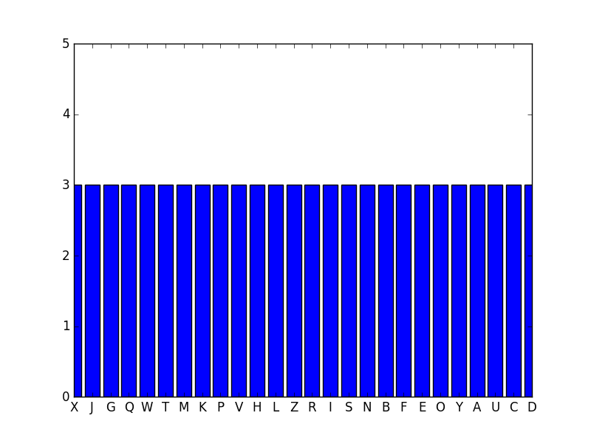
One Time Pad (OTP)
Algorithm:
1.) generate a truly random sequence (as many random numbers as the letters in the plaintext)
DO NOT REUSE THE SAME NUMBERS OVER AN OVER AGAIN
~ the private key is used one time as well (it is not reused for other messages)
2.) shift the letters in the plaintext with the random numbers in the same manner
as in Vigenere cipher or Caesar cipher
What will happen if we analyze the ciphertext with Kasiski-method?
→ there is no information leaking because every
letter in the ciphertext is equally likely
RANDOM NUMBERS CAN ELIMINATE INFORMATION LEAKING

Slide 122
One Time Pad (OTP)
EXAMPLE
Originally one time pad algorithm used XOR operation so first
we consider the binary representation
we find the ASCII value for every letter in the text
→ then we convert the decimal value into binary
For example: character a has the ASCII value 97. So what is the binary
representation of 97? It is 01100001
0
1
2
3
4
5
6
7
01100001 = 1x2 + 0x2 + 0x2 + 0x2 + 0x2 + 1x2 + 1x2 + 0x2 = 97

Slide 123
One Time Pad (OTP)
„XOR is an involution so
the function’s inverse is
the function itself”
EXAMPLE
Originally one time pad algorithm used XOR operation so first
we consider the binary representation
we find the ASCII value for every letter in the text
output is 0 or 1
with 50% probability
→ then we convert the decimal value into binary
So we want to shift every letter in the plaintext which means addition
Addition is the same as bitwise XOR (if there are no carry bits)
x
y
x XOR y
0
0
For example: let’s use XOR to add 16 and 10
0
0
1
2
3
4
5
6
7
0
1
1
00010000 = 0x2 + 0x2 + 0x2 + 0x2 + 1x2 + 0x2 + 0x2 + 0x2 = 16
0
1
2
3
4
5
6
7
00001010 = 0x2 + 1x2 + 0x2 + 1x2 + 0x2 + 0x2 + 0x2 + 0x2 = 10
1
0
1
00010000 | 00001010 = 00011010 = 26
1
1
0

Slide 124
One Time Pad (OTP)
EXAMPLE
Plaintext: HELLO
Key: 11001000001011101111011011000000

Slide 125
One Time Pad (OTP)
EXAMPLE
Plaintext: HELLO
Key: 11001000001011101111011011000000
1.) let’s convert the ASCII values of the letters into binary
72
69
76
76
79
H E L L O = 01001000010001010100110001001111
72 = 01001000
69 = 01000101
76 = 01001100
79 = 01001111

Slide 126
One Time Pad (OTP)
EXAMPLE
Plaintext: HELLO
Key: 11001000001011101111011011000000
2.) let’s do the XOR operation
01001000010001010100110001001111
11001000001011101111011011000000
XOR
10000000011010111011101010001111
This is the result of the XOR operation which means
this is the ciphertext !!!

Slide 127
One Time Pad (OTP)
EXAMPLE
Plaintext: HELLO
Key: 11001000001011101111011011000000
3.) because XOR operation’s inverse is XOR operation itself, we have to apply the same
transformation to get the plaintext again
10000000011010111011101010001111
11001000001011101111011011000000
XOR
01001000010001010100110001001111
This is how we get the plaintext from the ciphertext
with the same XOR operation

Slide 128
One Time Pad (OTP)
A B C D E F G H I J K L M N O P Q R S T U V W X Y Z
EXAMPLE
0
1
2
3
4
5
6
7
8
9
10
11
12
13
14
15
16
17
18
19
20
21
22
23
24
25
Plaintext: THIS IS JUST AN EXAMPLE
Random sequence: 49163259164381642843561
Ciphertext:
4
9
1
6
2
5
1
6
4
3
1
6
2
8
4
3
5
6
1
T H I S I S J U S T A N E X A M P L E
XQJY KX KAWW BT GFEPURF
E (x ) = (x + OTP ) mod 26
i
i
i
i

Slide 129
One Time Pad (OTP)
A B C D E F G H I J K L M N O P Q R S T U V W X Y Z
EXAMPLE
0
1
2
3
4
5
6
7
8
9
10
11
12
13
14
15
16
17
18
19
20
21
22
23
24
25
Ciphertext: XQJY KX KAWW BT GFEPURF
Random sequence: 49163259164381642843561
Plaintext: THIS IS JUTS AN EXAMPLE
4
9
1
6
2
5
1
6
4
3
1
6
2
8
4
3
5
6
1
X Q J Y K X K A W W B T G F E P U R F
D (x ) = (x - OTP ) mod 26
i
i
i
i

Slide 130
One Time Pad (OTP)
The main problem as far as one time pad is concerned is how
to generate the random numbers
„Random number generation is the generation of sequence of numbers
that can not be reasonably predicted better than by a random chance”
TRUE RANDOM NUMBERS PSEUDO-RANDOM NUMBERS (fake randomness)
If we measure some physical phenomenon then
we end up with true random numbers
For example: radioactive decay or atmospheric noise
→ values have uniform distribution
→ the values are independent of each other
→ not so efficient: quite expensive to
generate (measure) these numbers
Instead of measuring some physical phenomenon, we
use computers to generate random numbers
PROBLEM: computers are deterministic !!!
→ values have uniform distribution
→ values are NOT independent of each other
→ there are efficient algorithms to generate
these pseudo-random values

Slide 131
One Time Pad (OTP)
Pseudo-random numbers can repeat themself: so they may become quite predictable
~ which means the one-time-pad is no more secure
THE SECURITY OF ONE TIME PADS RELY ON PSEUDO-RANDOM NUMBERS
Computers are inherently deterministic so it is impossible to define
algorithms to generate true random numbers. But we can generate
pseudo-random numbers with these algorithms:
1.) middle-square method
2.) Mersenne twister
3.) linear congruential generators

Slide 132
One Time Pad (OTP)
MIDDLE-SQUARE METHOD
The input of the algorithm is a seed: because computers are programmed to
execute well-defined operations, it’s impossible to generate random numbers
→ but we can define algorithms to mimic randomness
~ these are the pseudo-random numbers
→ the initial position (this is the seed) determines the sequence itself
It was invented by
John von Neumann in 1949
The seed should be a truly random number: measurement of noise or
current time in milliseconds
THE SEED IS THE INPUT OF A SIMPLE CALCULATION
ALGORITHM: 1.) multiply the seed by itself
2.) get the middle of the result
3.) the result is the seed in the next iteration
The randomness of the sequence depends on the randomness of the seed exclusively

Slide 133
One Time Pad (OTP)
MIDDLE-SQUARE METHOD
ALGORITHM: 1.) multiply the seed by itself
2.) get the middle of the result
3.) the result is the seed in the next iteration

Slide 134
One Time Pad (OTP)
MIDDLE-SQUARE METHOD
ALGORITHM: 1.) multiply the seed by itself
2.) get the middle of the result
3.) the result is the seed in the next iteration
seed: 152

Slide 135
One Time Pad (OTP)
MIDDLE-SQUARE METHOD
ALGORITHM: 1.) multiply the seed by itself
2.) get the middle of the result
3.) the result is the seed in the next iteration
seed: 152
152 x 152 = 23104

Slide 136
One Time Pad (OTP)
MIDDLE-SQUARE METHOD
ALGORITHM: 1.) multiply the seed by itself
2.) get the middle of the result
3.) the result is the seed in the next iteration
seed: 152
152 x 152 = 23104
310

Slide 137
One Time Pad (OTP)
MIDDLE-SQUARE METHOD
ALGORITHM: 1.) multiply the seed by itself
2.) get the middle of the result
3.) the result is the seed in the next iteration
seed: 310
310 x 310= 96100
310

Slide 138
One Time Pad (OTP)
MIDDLE-SQUARE METHOD
ALGORITHM: 1.) multiply the seed by itself
2.) get the middle of the result
3.) the result is the seed in the next iteration
seed: 310
310 x 310= 96100
310610

Slide 139
One Time Pad (OTP)
MIDDLE-SQUARE METHOD
ALGORITHM: 1.) multiply the seed by itself
2.) get the middle of the result
3.) the result is the seed in the next iteration
seed: 610
610 x 610= 372100
310610

Slide 140
One Time Pad (OTP)
MIDDLE-SQUARE METHOD
ALGORITHM: 1.) multiply the seed by itself
2.) get the middle of the result
3.) the result is the seed in the next iteration
seed: 610
610 x 610= 372100
310610210

Slide 141
One Time Pad (OTP)
MIDDLE-SQUARE METHOD
It is a pseudo-random number sequence: so first problem is that if we
know the initial seed, we can reproduce the sequence
→ if the algorithm reaches a seed it previously used then
the sequence keeps repeating itself
→ this is called the period: the length before a pseudo-random
sequence repeats
→ the period depends on the initial seed exclusively
2 digits seed: algorithm uses at most 100 digits before reusing the seed
3 digits seed: algorithm uses at most 1000 digits before reusing the seed
.
.
N digits seed: algorithm uses 10 digits before reusing the seed
N

Slide 142
One Time Pad (OTP)
MIDDLE-SQUARE METHOD
So if we use a pseudo-random numbers, there are many
sequences that can not occur
→ by using pseudo-random numbers, the key-space is
reduced to a much smaller seed-space
→ which means the one time pad is not that secure any more

Slide 143
One Time Pad (OTP)
LINEAR CONGRUENTIAL GENERATOR
X = ( a X + c ) mod m
n+1
n
as usual we have to define a seed which is the X
the values of the parameters a, c and m determine the period
0

Slide 144
One Time Pad (OTP)
Caesar cipher’s keyspace = 26
Vigenere cipher’s keyspace = 26
One time pad’s keyspace = 26
SIZE OF THE KEY
SIZE OF THE PLAINTEXT
In theory it is impossible to break a one time pad BUT:
→ generating perfectly random numbers (as keys) is extremely hard
~ almost impossible to get truly random numbers with computers
(random sequence with small period: Vigenere-cipher)
→ the key has the same length as the plaintext: if we are able to exchange this key
securely then why not to exchange the plaintext itself?

Slide 145
One Time Pad (OTP)
We are not able to break one time pad with brute-force approach
M {0,1}
C {0,1}
Because the size of the message space |M| is the same as
the size of the ciphertext space |C| it means perfect secrecy
SHANNON’S PERFECT SECRECY
n
n
P(M=m|C=c) = P(M=m)
message space
ciphertext space
perfect secrecy is when |M| = |C|
we are not able to use brute-force approach because we will find all the valid plaintexts
~ which contains every valid words and sentences in english
How to decide what was the original message?

Slide 146
Data Encryption Standard (DES)
In the early 1970s it became apparent that the commercial sector
also has a need for cryptography
For example: corporate secrets must have been transmitted securely, ATM machines
needed encrypted messages etc.
Data Encryption Standard (DES) is a symmetric-key algorithm
it was constructed in the early 1970 at IBM (designed mostly by Horst Feistel)
it is a block cipher: the plaintext is processed to the ciphertext in number of blocks
hybrid of substitution cipher and permutation cipher
~ we are not able to use frequency analysis to crack DES

Slide 147
Data Encryption Standard (DES)
Data Encryption Standard (DES) has a so-called Feistel-structure
1.) we have to split the plaintext into 64 bits long blocks
~ these blocks are the input in for the 16 rounds
2.) there are so-called rounds (iteration) during the encryption/decryption
~ for DES there are 16 rounds (substitutions, XOR operations etc.)
+ the input for every iteration is a 64 bits long block
3.) every round needs a different keys (it is called subkeys)
These keys are generated from the original 64 bits private key
4.) it’s main advantage is that encryption and decryption operations are very similar
(requiring only the reversal of the key schedule)
Block size: 64 bits
Key size: 64 bits (56 relevant bits are used in the algorithm)
Number of rounds: 16
Number of subkeys: 16 (every subkey is 48 bits long)
Ciphertext size: 64 bits

Slide 148
Data Encryption Standard (DES)
DIAGRAM OF DES
DATA ENCRYPTION STANDARD
block of plaintext
(64 bits)
T
R
A
N
S
P
O
S
I
T
I
O
N
T
R
A
N
S
P
O
S
I
T
I
O
N
ROUND
1
ROUND 2
ROUND 3
ROUND 16
...
block ofciphertext
(64 bits)
key
(64 bits)

Slide 149
Data Encryption Standard (DES)
64 bits long plaintext block
64 bits long private key
we are going to shuffle the order
of the bits in the block containing 64 bits
shuffle the order of the bits
and omit 8 bits
(output contains 56 bits only)
initial permutation (IP)
permuted choice 1 (PC-1)
56 bits
48 bits
permuted choice 2 (PC-2)
56 bits
round #1
left circular shift
56 bits
48 bits
permuted choice 2 (PC-2)
56 bits
round #2
left circular shift
.
.
.
.
.
.
.
.
.
round #16
48 bits
permuted choice 2 (PC-2)
56 bits
left circular shift
shift all the bits to the left
(a table defines the number of shifts)
32 bit swap
left half (32 bits) and right
half (32 bits) are swapped
-1
64 bits
inverse permutation (IP )
CIPHERTEXT

Slide 150
Data Encryption Standard (DES)
What is left circular shift?
→ a circular shift (bitwise rotation) is an operator that shifts all the bits
→ in the implementation of DES sometimes we have to shift by 1
and sometimes we have to shift by 2
Round #1: 1 Round #9: 1
Round #2: 1 Round #10: 2
Round #3: 2 Round #11: 2
Round #4: 2 Round #12: 2
Round #5: 2 Round #13: 2
Round #6: 2 Round #14: 2
Round #7: 2 Round #15: 2
Round #8: 2 Round #16: 1
If we want to shift 01001000 to the left then the result
will be 10010000
0
1
0
0
1
0
0
0

Slide 151
Data Encryption Standard (DES)
What is left circular shift?
→ a circular shift (bitwise rotation) is an operator that shifts all the bits
→ in the implementation of DES sometimes we have to shift by 1
and sometimes we have to shift by 2
Round #1: 1 Round #9: 1
Round #2: 1 Round #10: 2
Round #3: 2 Round #11: 2
Round #4: 2 Round #12: 2
Round #5: 2 Round #13: 2
Round #6: 2 Round #14: 2
Round #7: 2 Round #15: 2
Round #8: 2 Round #16: 1
If we want to shift 01001000 to the left then the result
will be 10010000
0
1
0
0
1
0
0
0

Slide 152
Data Encryption Standard (DES)
What is left circular shift?
→ a circular shift (bitwise rotation) is an operator that shifts all the bits
→ in the implementation of DES sometimes we have to shift by 1
and sometimes we have to shift by 2
Round #1: 1 Round #9: 1
Round #2: 1 Round #10: 2
Round #3: 2 Round #11: 2
Round #4: 2 Round #12: 2
Round #5: 2 Round #13: 2
Round #6: 2 Round #14: 2
Round #7: 2 Round #15: 2
Round #8: 2 Round #16: 1
If we want to shift 01001000 to the left then the result
will be 10010000
1
0
0
1
0
0
0
0

Slide 153
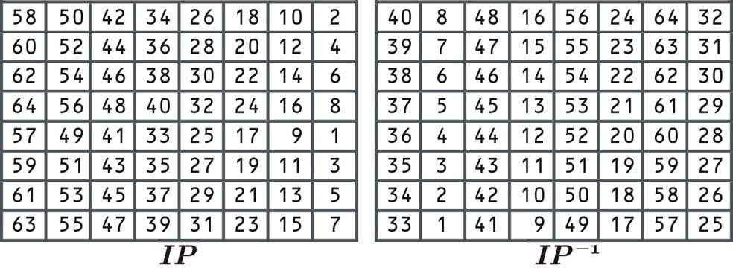
Data Encryption Standard (DES)
What is the initial permutation and its inverse?
These are constant values: this is what we use in the implementation
~ input of DES is a 64 bits long plaintext: 8x8=64
(by the way it is stored as a vector and not as a matrix)
→ the values define what bits to use in the given positions
THESE TABLES DEFINE THE LOCATION OF THE GIVEN BITS

Slide 154
Data Encryption Standard (DES)
What is the round-function?
32 bits
32 bits
28 bits
28 bits
L
R
K
K
l
r
expansion function
circular left shift
circular left shift
48 bits
XOR
48 bits
permuted choice 2 (PC-2)
48 bits
S-BOX
K
in the next round
K
in the next round
l
r
32 bits
permutation
„ROUND FUNCTION”
32 bits
XOR
L
in the next round
R
in the next round

Slide 155
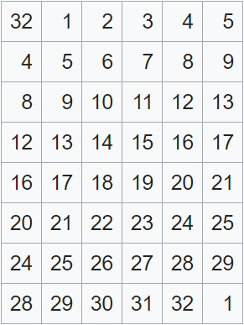
Data Encryption Standard (DES)
What is the expansion function?
In this phase the DES algorithm transforms a 32 bits input
into a 48 bits output
→ of course it means some bits are duplicated
→ 16 extra bits will be added: the bits in the left column
and the bits in the right column

Slide 156
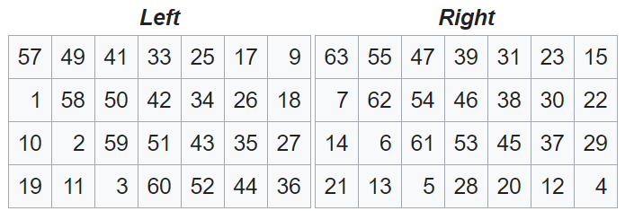
Data Encryption Standard (DES)
What is the permuted choice 1 (PC-1)?
The 64 bits long private key is splitted into two 32 bits long left- and right keys
→ note that only 56 bits of the original 64 bits are selected
→ we omit some bits (8, 16, 24, 32, 40, 48, 56 and 64)

Slide 157
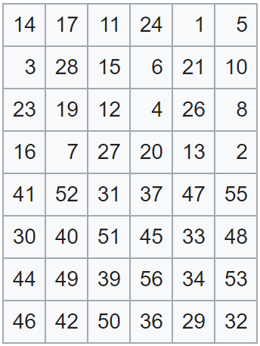
Data Encryption Standard (DES)
What is the permuted choice 2 (PC-2)?
This table again defines the location of the given bits
→ some bits are not used
→ this is why this PC-2 selects 48 bits from the
original 56 bits long key

Slide 158
Data Encryption Standard (DES)
What are the S-BOXES?
There are 8 s-boxes in the DES algorithm: these are substitution boxes
~ the input for the boxes is 6 bits and the output is 4 bits
(this is why we tranform 48 bits into a 32 bits output)
s s s s s s s s
6 bits
6 bits
6 bits
6 bits
6 bits
6 bits
6 bits
6 bits
1
2
3
4
5
6
7
8
4 bits
4 bits
4 bits
4 bits
4 bits
4 bits
4 bits
4 bits
each of these s-boxes contains 64 items
these s-boxes are basically lookup-tables: the 6 bits input defines the row
and column index in the given s-box and the value associated with that
index yields the 4 bits output
computer scientists like
lookup tables because
of the O(1) complexity

Slide 159
Data Encryption Standard (DES)
What are the S-BOXES?
0 1 1 0 1 1
The least-significant bit (LSB) and the most-significant bit (MSB)
defines the row index in the s-box (which is a lookup table)
01 → it identifies the row in the s-box
The middle 4 bits defines the column index in the s-box
1101 → it defines the column in the s-box
S-BOX | 0000 | 0001 | 0010 | 0011 | 0100 | 0101 | 0110 | 0111 | 1000 | 1001 | 1010 | 1011 | 1100 | 1101 | 1110 | 1111
00 | 0010 | 0100 | 1001 | 1011 | 1111 | 1011 | 0010 | 1011 | 1110 | 1111 | 1111 | 1011 | 1010 | 0100 | 0110 | 0001
01 | 0010 | 0100 | 1001 | 1011 | 1111 | 1011 | 0010 | 1011 | 1110 | 1111 | 1111 | 1011 | 1010 | 0100 | 0110 | 0001
10 | 0010 | 0100 | 1001 | 1011 | 1111 | 1011 | 0010 | 1011 | 1110 | 1111 | 1111 | 1011 | 1010 | 0100 | 0110 | 0001
11 | 0010 | 0100 | 1001 | 1011 | 1111 | 1011 | 0010 | 1011 | 1110 | 1111 | 1111 | 1011 | 1010 | 0100 | 0110 | 0001

Slide 160
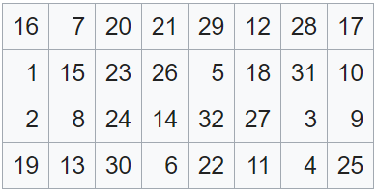
Data Encryption Standard (DES)
What is the permutation?
We have to apply this permutation after using the s-boxes
→ the input is 32 bits and the output is 32 bits
→ the order of the bits are changed according to
the values within this table

Slide 161
Data Encryption Standard (DES)
The main advantage of Feistel-structures is that encryption is very similar to decryption
~ the same software and hardware can be used
→ we just have to use the same function we have used with encryption
with the subkeys in a reverse order !!!
→ the subkeys can be generated with circular left shift operations
Usually in the implementation we generate all the 16 subkey at the beginning
Encryption: we start with the first subkey then second ...
Decryption: we start with the last (16-th) subkey ...

Slide 162
Brute Force Crack
of course again we can use brute-force approach to check all the possible
values for the keys
DES keyspace’s size = 2
56
the small size of the keyspace is the reason why DES
cryptosystem is no longer secure
„Deep Crack” has managed to crack DES with brute-force attack within 22 hours
~ it does not use any internal structure of the cryptosystem
just considers all the possible keys (linear search)
This is why DES was replaced by triple DES (TDES) and later with AES

Slide 163
Linear Cryptoanalysis
Linear cryptoanalysis was constructed by Mitsuru Matsui in 1992
~ it is a widely used attack on block ciphers such as DES
DES cryptosystem has linear transformations except for the S-BOX
S-BOX transforms 6 bits to 4 bits (non-linear transformation)
S-BOX
6 bits
4 bits
How to determine the values within the s-boxes? Of course the aim is to make sure the
output is very similar to true random numbers
~ there was a concern that a backdoor might have been planted in DES
(so only the designers can break the cryptosystem)
SCIENTISTS STATED THAT EVEN A SMALL MODIFICATION COULD WEAKEN DES !!!

Slide 164
Linear Cryptoanalysis
Linear cryptoanalysis needs N plaintext / ciphertext pairs
→ for cracking DES we need 2 known plaintexts so this approach is not
practical when cracking DES
→ usually linear cryptoanalysis is faster than brute-force approach
47
This approach assumes a linear relationship between the elements (individual bits) of
the plaintext, the ciphertext and the key
So this approach tries to find an f linear approximation
such that ciphertext = f(plaintext,key)
AGAIN WE ARE LOOKING FOR INFORMATION LEAKING (NON-RANDOM BEHAVIOR)
~ the aim of permutations and mainly the S-box is to
end up with a random sequence

Slide 165
Differential Cryptoanalysis
Differential cryptoanalysis needs N plaintext / ciphertext pairs
AGAIN WE ARE LOOKING FOR INFORMATION LEAKING (NON-RANDOM BEHAVIOR)
~ the aim of permutations and mainly the S-box is to
end up with a random sequence
This approach aim to map bitwise ΔX differences in the input (plaintext) to ΔY differences
in the output (ciphertext)
→ of course the aim is to reverse-engineer the cryptosystem
→ we analyse what will happen to the output if we make a little
change in the input

Slide 166
Advanced Encryption Standard (AES)
It became apparent that DES is no longer secure: so there was a need for
another truly secure cryptosystem
→ AES (original name is Rijndael) was constructed in 2001
by Vincent Rijmen and Joan Daemen
→ this is the state-of-the-art cryptosystem even in 2018
→ it is a private key cryptosystem with three different keylenghts – 128, 192 and 256
→ it is a block cipher BUT it has nothing to do with Feistel structure
~ it stores the values (plaintext, key, ciphertext) in matrix form

Slide 167
Advanced Encryption Standard (AES)
Plaintext block: 128 bits (4 words because 1 word is 32 bits)
Key size: 128 bits (4 words)
Number of subkeys: 10 subkeys
Number of rounds: 10 rounds (or 12 or 14)
In each round we use 1 subkey + we have to use the original
128 bits long key before applying the round-function
Ciphertext block: 128 bits

Slide 168
Advanced Encryption Standard (AES)
We represent the data (plaintext, ciphertext and key) as matrixes
p
p
p
p
k
k
k
k
0
4
8
12
0
4
8
12
p
p
p
p
k
k
k
k
1
5
9
13
1
5
9
13
we store the output, the intermediate result
and the key as a matrix like this
p
p
p
p
k
k
k
k
2
6
10
14
2
6
10
14
p
p
p
p
k
k
k
k
3
7
11
15
3
7
11
15
every entry within this matrix is a byte (8 bits) thats why 16x8=128 bits
every column represents a word (1 word is 32 bits)
note: it is a column by column representation

Slide 169
Advanced Encryption Standard (AES)
128 bits long plaintext block
128 bits long private key
add round key
K [w ...w ]
0
0
3
128 bits
S-BOX (substitute bytes)
„ROUND FUNCTION”
128 bits
In every round we make a substitution
so the S-BOX, then mix rows and columns
and finally add round key operation
~ in every round we use a different
subkey. We generate subkeys
from the private key
IN THE LAST ROUND WE DO NOT USE THE MIX COLUMNS OPERATION !!!
shift rows (left shift)
128 bits
mix columns
128 bits
add round key
K [w ...w ]
1
4
7

Slide 170
Advanced Encryption Standard (AES)
ADD ROUND KEY OPERATION
As we have seen with DES cryptosystem the operations are
substitution, permutation and XOR operation
add round key operation = XOR
output is 0 or 1
with 50% probability
x
y
x XOR y
input plaintext block is 128 bits long sequence
private key is a 128 bits long binary sequence
we just have to use bitwise XOR operation on a bit-by-bit basis
0
0
0
0
1
1
1
0
1
1
1
0

Slide 171
Advanced Encryption Standard (AES)
SUBSTITUTION BYTES OPERATION (S-BOX)
p
p
p
p
0
4
8
12
p
p
p
p
1
5
S-BOX
9
13
8 bits
8 bits
p
p
p
p
2
6
10
14
p
p
p
p
3
7
11
15
We consider all the items (16 items) in the matrix
+ for every item we apply the s-box: return 8 bits as an output
0 1 0 1 1 1 0 0
because we have 4 bits for the rows
and 4 bits for the column thats why
this look-up table is 16x16
ROW INDEX
COLUMN INDEX

Slide 172
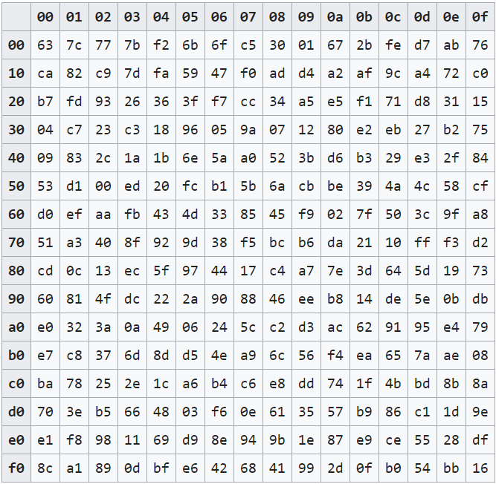
Advanced Encryption Standard (AES)
SUBSTITUTION BYTES OPERATION (S-BOX)
This is the S-BOX used in AES cryptosystem
~ the values are carefully chosen to be resistant to
linear and differential cryptoanalysis

Slide 173
Advanced Encryption Standard (AES)
SHIFT ROWS OPERATION (CIRCULAR LEFT SHIFT)
s
s
s
s
circular left shift with 0 step
0
4
8
12
s
s
s
s
circular left shift with 1 steps
1
5
9
13
s
s
s
s
2
6
14
circular left shift with 2 steps
10
s
s
s
s
3
7
11
circular left shift with 3 steps
15

Slide 174
Advanced Encryption Standard (AES)
SHIFT ROWS OPERATION (CIRCULAR LEFT SHIFT)
s
s
s
s
s
s
s
s
0
4
8
12
0
4
8
12
s
s
s
s
s
s
s
s
1
5
9
13
5
9
13
1
s
s
s
s
s
s
s
s
2
6
10
14
10
14
2
6
s
s
s
s
s
s
s
s
3
7
11
15
15
3
7
11

Slide 175
Advanced Encryption Standard (AES)
MIX COLUMNS OPERATION
s
s
s
s
2
3
1
1
0
4
8
12
s
s
s
s
1
2
3
1
1
5
9
13
s
s
s
s
1
1
2
3
2
6
10
14
s
s
s
s
3
1
1
2
3
7
11
15
this step in AES is a matrix-vector multiplication
we take the columns from the state-matrix and multiply the predefined
matrix with these vectors

Slide 176
Advanced Encryption Standard (AES)
MIX COLUMNS OPERATION
2
3
1
1
s
s’
0
0
1
2
3
1
s
s’
1
1
X =
1
1
2
3
s
s’
2
2
3
1
1
2
s
s’
3
3

Slide 177
Advanced Encryption Standard (AES)
MIX COLUMNS OPERATION
2
3
1
1
s
s’
4
4
1
2
3
1
s
s’
5
5
X =
1
1
2
3
s
s’
6
6
3
1
1
2
s
s’
7
7

Slide 178
Advanced Encryption Standard (AES)
MIX COLUMNS OPERATION
2
3
1
1
s
s’
8
8
1
2
3
1
s
s’
9
9
X =
1
1
2
3
s
s’
10
10
3
1
1
2
s
s’
11
11

Slide 179
Advanced Encryption Standard (AES)
MIX COLUMNS OPERATION
2
3
1
1
s
s’
12
12
1
2
3
1
s
s’
13
13
X =
1
1
2
3
s
s’
14
14
3
1
1
2
s
s’
15
15

Slide 180
Advanced Encryption Standard (AES)
MIX COLUMNS OPERATION
s
s
s
s
s’
s’
s’
s’
0
4
8
12
0
4
8
12
s
s
s
s
s’
s’
s’
s’
1
5
9
13
1
5
9
13
s
s
s
s
s’
s’
s’
s’
2
6
10
14
2
6
10
14
s
s
s
s
s’
s’
s’
s’
3
7
11
15
3
7
11
15
Problem: here we are dealing with a so-called Galois-field
So how to multiple a binary sequence by 3?
→ multiplication is (approximately) the left shift binary operation
→ addition is the XOR operation

Slide 181
Advanced Encryption Standard (AES)
SUBKEY GENERATION
1b
22
cb
03
7c
ae
f4
ba
...
14
01
1b
4f
09
a6
88
4a

Slide 182
Advanced Encryption Standard (AES)
SUBKEY GENERATION
1b
22
cb
03
7c
ae
f4
ba
...
14
01
1b
4f
09
a6
88
4a

Slide 183
Advanced Encryption Standard (AES)
SUBKEY GENERATION
1b
22
cb
03
7c
ae
f4
ba
...
14
01
1b
4f
09
a6
88
4a

Slide 184
Advanced Encryption Standard (AES)
SUBKEY GENERATION
1b
22
cb
03
7c
ae
f4
ba
...
14
01
1b
4f
09
a6
88
4a
03
First we have to apply the rotation operation which means
binary left shift but in this case we shift the bytes
one step upwards in a circular manner
ba
4f
4a

Slide 185
Advanced Encryption Standard (AES)
SUBKEY GENERATION
1b
22
cb
03
7c
ae
f4
ba
...
14
01
1b
4f
09
a6
88
4a
ba
First we have to apply the rotation operation which means
binary left shift but in this case we shift the bytes
one step upwards in a circular manner
4f
4a
03

Slide 186
Advanced Encryption Standard (AES)
SUBKEY GENERATION
1b
22
cb
03
7c
ae
f4
ba
...
14
01
1b
4f
09
a6
88
4a
ba
Then we have to use the same S-BOX we have used
within the round function
→ first 4 bits: row index in the look-up table
→ last 4 bits: column index in the table
4f
4a
03

Slide 187
Advanced Encryption Standard (AES)
SUBKEY GENERATION
1b
22
cb
03
7c
ae
f4
ba
...
14
01
1b
4f
09
a6
88
4a
f4
Then we have to use the same S-BOX we have used
within the round function
→ first 4 bits: row index in the look-up table
→ last 4 bits: column index in the table
84
d6
7b

Slide 188
Advanced Encryption Standard (AES)
SUBKEY GENERATION
K
K
K
i-4
i-1
i
1b
22
cb
03
7c
ae
f4
ba
...
14
01
1b
4f
09
a6
88
4a
f4
Then we have to use XOR operation with previous words in the key
and the values in the rcon table
~ the first value of the table is never used
84
d6
7b

Slide 189
Advanced Encryption Standard (AES)
SUBKEY GENERATION
K
K
K
i-4
i-1
i
1b
22
cb
03
7c
ae
f4
ba
...
14
01
1b
4f
09
a6
88
4a
1b
f4
01
03
7c
84
00
ab
XOR
XOR
=
14
d6
00
4c
09
7b
00
a5

Slide 190
Advanced Encryption Standard (AES)
SUBKEY GENERATION
K
K
K
i-4
i-1
i
1b
22
cb
03
03
7c
ae
f4
ba
ab
...
14
01
1b
4f
4c
09
a6
88
4a
a5
1b
f4
01
03
7c
84
00
ab
XOR
XOR
=
14
d6
00
4c
09
7b
00
a5

Slide 191
Advanced Encryption Standard (AES)
SUBKEY GENERATION
1b
22
cb
03
03
7c
ae
f4
ba
ab
...
14
01
1b
4f
4c
09
a6
88
4a
a5

Slide 192
Advanced Encryption Standard (AES)
SUBKEY GENERATION
1b
22
cb
03
03
7c
ae
f4
ba
ab
...
14
01
1b
4f
4c
09
a6
88
4a
a5

Slide 193
Advanced Encryption Standard (AES)
SUBKEY GENERATION
K
K
K
i-4
i-1
i
1b
22
cb
03
03
7c
ae
f4
ba
ab
...
14
01
1b
4f
4c
09
a6
88
4a
a5

Slide 194
Advanced Encryption Standard (AES)
SUBKEY GENERATION
K
K
K
i-4
i-1
i
1b
22
cb
03
03
7c
ae
f4
ba
ab
...
14
01
1b
4f
4c
09
a6
88
4a
a5

Slide 195
Advanced Encryption Standard (AES)
SUBKEY GENERATION
K
K
K
i-4
i-1
i
1b
22
cb
03
03
7c
ae
f4
ba
ab
...
14
01
1b
4f
4c
09
a6
88
4a
a5
22
03
01
ae
ab
22
XOR
=
01
4c
a3
a6
a5
88

Slide 196
Advanced Encryption Standard (AES)
SUBKEY GENERATION
K
K
K
i-4
i-1
i
1b
22
cb
03
03
01
7c
ae
f4
ba
ab
22
...
14
01
1b
4f
4c
03
09
a6
88
4a
a5
88

Slide 197
Advanced Encryption Standard (AES)
SUBKEY GENERATION
1b
22
cb
03
03
01
7c
ae
f4
ba
ab
22
...
14
01
1b
4f
4c
03
09
a6
88
4a
a5
88

Slide 198
Advanced Encryption Standard (AES)
SUBKEY GENERATION
1b
22
cb
03
03
01
7c
ae
f4
ba
ab
22
...
14
01
1b
4f
4c
03
09
a6
88
4a
a5
88

Slide 199
Advanced Encryption Standard (AES)
SUBKEY GENERATION
K
K
K
i-4
i-1
i
1b
22
cb
03
03
01
7c
ae
f4
ba
ab
22
...
14
01
1b
4f
4c
03
09
a6
88
4a
a5
88

Slide 200
Advanced Encryption Standard (AES)
SUBKEY GENERATION
K
K
K
i-4
i-1
i
1b
22
cb
03
03
01
7c
ae
f4
ba
ab
22
...
14
01
1b
4f
4c
03
09
a6
88
4a
a5
88

Slide 201
Advanced Encryption Standard (AES)
SUBKEY GENERATION
K
K
K
i-4
i-1
i
1b
22
cb
03
03
01
7c
ae
f4
ba
ab
22
...
14
01
1b
4f
4c
03
09
a6
88
4a
a5
88
cb
01
f1
f4
22
ac
XOR
=
1b
03
02
88
88
22

Slide 202
Advanced Encryption Standard (AES)
SUBKEY GENERATION
K
K
K
i-4
i-1
i
1b
22
cb
03
03
01
f1
7c
ae
f4
ba
ab
22
ac
...
14
01
1b
4f
4c
03
02
09
a6
88
4a
a5
88
22

Slide 203
Advanced Encryption Standard (AES)
SUBKEY GENERATION
1b
22
cb
03
03
01
f1
7c
ae
f4
ba
ab
22
ac
...
14
01
1b
4f
4c
03
02
09
a6
88
4a
a5
88
22

Slide 204
Advanced Encryption Standard (AES)
SUBKEY GENERATION
1b
22
cb
03
03
01
f1
7c
ae
f4
ba
ab
22
ac
...
14
01
1b
4f
4c
03
02
09
a6
88
4a
a5
88
22

Slide 205
Advanced Encryption Standard (AES)
SUBKEY GENERATION
1b
22
cb
03
03
01
f1
7c
ae
f4
ba
ab
22
ac
...
14
01
1b
4f
4c
03
02
09
a6
88
4a
a5
88
22

Slide 206
Advanced Encryption Standard (AES)
SUBKEY GENERATION
K
K
K
i-4
i-1
i
1b
22
cb
03
03
01
f1
7c
ae
f4
ba
ab
22
ac
...
14
01
1b
4f
4c
03
02
09
a6
88
4a
a5
88
22
03
f1
23
ba
ac
a3
XOR
=
4f
02
39
4a
22
39

Slide 207
Advanced Encryption Standard (AES)
SUBKEY GENERATION
1b
22
cb
03
03
01
f1
23
7c
ae
f4
ba
ab
22
ac
a3
...
14
01
1b
4f
4c
03
02
39
09
a6
88
4a
a5
88
22
39

Slide 208
Advanced Encryption Standard (AES)
SUBKEY GENERATION
1b
22
cb
03
03
01
f1
23
7c
ae
f4
ba
ab
22
ac
a3
...
14
01
1b
4f
4c
03
02
39
09
a6
88
4a
a5
88
22
39

Slide 209
Advanced Encryption Standard (AES)
SUBKEY GENERATION
1b
22
cb
03
03
01
f1
23
7c
ae
f4
ba
ab
22
ac
a3
...
14
01
1b
4f
4c
03
02
39
09
a6
88
4a
a5
88
22
39

Slide 210
Advanced Encryption Standard (AES)
SUBKEY GENERATION
1b
22
cb
03
03
01
f1
23
7c
ae
f4
ba
ab
22
ac
a3
...
14
01
1b
4f
4c
03
02
39
09
a6
88
4a
a5
88
22
39

Slide 211
Advanced Encryption Standard (AES)
SUBKEY GENERATION
1b
22
cb
03
03
01
f1
23
7c
ae
f4
ba
ab
22
ac
a3
...
14
01
1b
4f
4c
03
02
39
09
a6
88
4a
a5
88
22
39
23
First we have to apply the rotation operation which means
binary left shift but in this case we shift the bytes
one step upwards in a circular manner
a3
39
39

Slide 212
Advanced Encryption Standard (AES)
SUBKEY GENERATION
1b
22
cb
03
03
01
f1
23
7c
ae
f4
ba
ab
22
ac
a3
...
14
01
1b
4f
4c
03
02
39
09
a6
88
4a
a5
88
22
39
a3
First we have to apply the rotation operation which means
binary left shift but in this case we shift the bytes
one step upwards in a circular manner
39
39
23

Slide 213
Advanced Encryption Standard (AES)
SUBKEY GENERATION
1b
22
cb
03
03
01
f1
23
7c
ae
f4
ba
ab
22
ac
a3
...
14
01
1b
4f
4c
03
02
39
09
a6
88
4a
a5
88
22
39
a3
Then we have to use the same S-BOX we have used
within the round function
→ first 4 bits: row index in the look-up table
→ last 4 bits: column index in the table
39
39
23

Slide 214
Advanced Encryption Standard (AES)
SUBKEY GENERATION
1b
22
cb
03
03
01
f1
23
7c
ae
f4
ba
ab
22
ac
a3
...
14
01
1b
4f
4c
03
02
39
09
a6
88
4a
a5
88
22
39
3a
Then we have to use the same S-BOX we have used
within the round function
→ first 4 bits: row index in the look-up table
→ last 4 bits: column index in the table
12
12
26

Slide 215
Advanced Encryption Standard (AES)
SUBKEY GENERATION
1b
22
cb
03
03
01
f1
23
7c
ae
f4
ba
ab
22
ac
a3
...
14
01
1b
4f
4c
03
02
39
09
a6
88
4a
a5
88
22
39
03
3a
02
ac
ab
12
00
02
XOR
XOR
=
4c
12
00
11
a5
26
00
f5

Slide 216
Advanced Encryption Standard (AES)
SUBKEY GENERATION
1b
22
cb
03
03
01
f1
23
ac
7c
ae
f4
ba
ab
22
ac
a3
02
...
14
01
1b
4f
4c
03
02
39
11
09
a6
88
4a
a5
88
22
39
f5

Slide 217
Advanced Encryption Standard (AES)
CONFUSION AND DIFFUSION
Claude Shannon defined these properties of a secure cipher
1.) confusion: each binary digit of the ciphertext should depend on
several digits of the private key
→ we want to make the relationship between the input (plaintext)
and output (ciphertext) as complex as possible
→ aim: the ciphertext should give no clue about the plaintext
~ this is why non-linear transformation are preferred
(these operations destroy pattern in the plaintext)
+ makes it hard to find the key even if large number of
plaintext-ciphertext pairs are available
THIS IS WHY WE USE SUBSTITUTION BOXES

Slide 218
Advanced Encryption Standard (AES)
CONFUSION AND DIFFUSION
Claude Shannon defined these properties of a secure cipher
2.) diffusion: if we change a single bit in the input (plaintext) then half of the digits in the
output (ciphertext) should change
→ there are 2 states (0 and 1) so 50% means randomness
„avalanche effect”
→ we want to make the relationship between the input (plaintext)
and output (ciphertext) as complex as possible
→ aim: the ciphertext should give no clue about the plaintext
~ this is why non-linear transformation are preferred
(these operations destroy pattern in the plaintext)
THIS IS WHY WE USE PERMUTATION BOXES

Slide 219
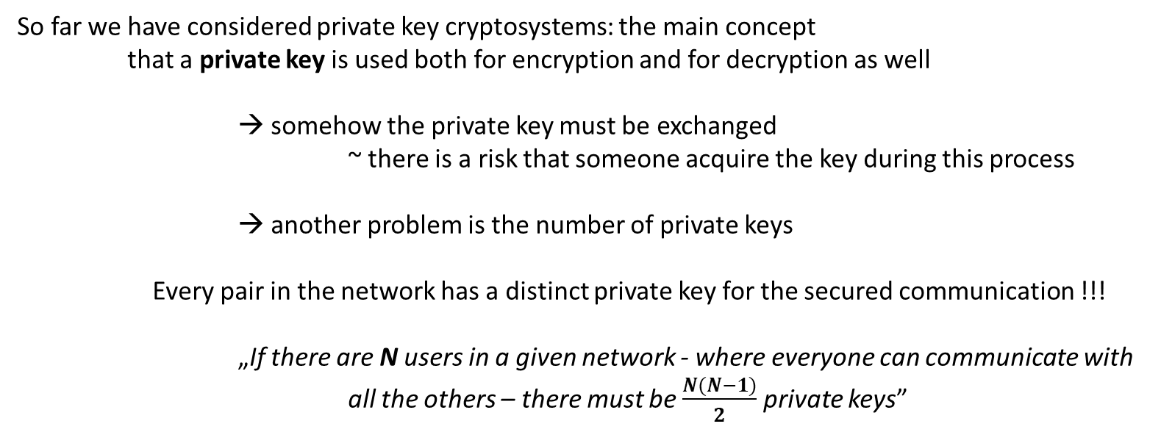
Problems With Private Key Cryptography
So far we have considered private key cryptosystems: the main concept
that a private key is used both for encryption and for decryption as well
→ somehow the private key must be exchanged
~ there is a risk that someone acquire the key during this process
→ another problem is the number of private keys
Every pair in the network has a distinct private key for the secured communication !!!
„If there are N users in a given network - where everyone can communicate with
all the others – there must be $\frac{N(N−1)}{2}$ private keys”
there are ~500.000
bitcoin users
Public key cryptosystems solve these problems: every user in the network has just
a single private key and a single public key (so N users have 2N keys)
→ in public key cryptosystems we know who is the sender: it is not
always straightforward in symmetric cryptosystems

Slide 220


Public Key Cryptography
In a publiy key (asymmetric) cryptosystem all the users have two keys: public key and a private key
→ these keys are not independent of each other
→ the private key can decrypt a message that has been encrypted with the
public key and vica versa
plaintext
E(p)
ciphertext
ciphertext
D(c)
plaintext
SENDER
RECEIVER
Everyone can send a decrypted message to a given user using his/her public key and only
the given user can decrypt that message using the private key

Slide 221
Public Key Cryptography
There is a huge difference between private key crytography and public key
cryptosystems: the aspiration itself !!!
SYMMETRIC CRYPROGRAPHY (private key cryptosystems)
→ we want to make sure the ciphertext contains no information about the plaintext
→ this is why we use random numbers more precisely pseudo-random numbers
If we can generate good pseudo-random numbers then there will be no
information leaking so the cryptosystem will be secure
THIS IS WHY PRIVATE KEY CRYPTOSYSTEMS ARE ABOUT RANDOMNESS

Slide 222
Public Key Cryptography
There is a huge difference between private key crytography and public key
cryptosystems: the aspiration itself !!!
ASYMMETRIC CRYPROGRAPHY (public key cryptosystems)
→ we use trapdoor functions: so we rely heavily on the fact that there are some operations
that are extremely hard to do (exponential running time complexity)
→ this is why we have to talk about modular arithmetic
For example: prime factorization or the discrete logarithm problem
PUBLIC KEY CRYPTOSYSTEMS ARE ABOUT PRIME NUMBERS !!!

Slide 223

Modular Arithmetic
„Modular arithmetic is a system of arithmetic for integers where numbers
wrap around upon reaching a certain value - the modulus”
dividend
remainder
$$\frac{a}{b}$$
= q remainder r
divisor
quotient
in modular arithmetic we are only interested in the remainder
to get the remainder we can use the modulo operator (%)
a mod b = remainder when we divide a by b

Slide 224
Modular Arithmetic
„Modular arithmetic is a system of arithmetic for integers where numbers
wrap around upon reaching a certain value - the modulus”
9 mod 4 = 1 because 9 = 2x4+1
13 mod 10 = 3 because 13=1x10+3

Slide 225
Modular Arithmetic
CONGRUENCE
Two integers (a and b) are said to be congruent if they have the same
remainder when divided by a specified integer m
a ≡ b (mod m)
congruence is not an operation it just defines a relationship between a and b
the mod m operation partition all the natural numbers into m subgroups
For example: the mod 2 operator decides whether a given number is
even or odd (so 2 groups)

Slide 226
Modular Arithmetic
FERMAT’S LITTLE THEOREM
What is a prime number?
A prime number greater than 1 whose only factors are 1 and itself
~ numbers that have more than 2 factors are called composite numbers
Let p be a prime number then for any integer a (a is not divisible by p) the number
a - 1 is an integer multiple of p.
p-1
p-1
p-1
a ≡ 1 (mod p) or
a -1 ≡ 0 (mod p)
„Fermat’s little theorem”

Slide 227
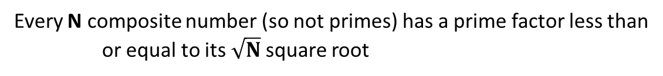
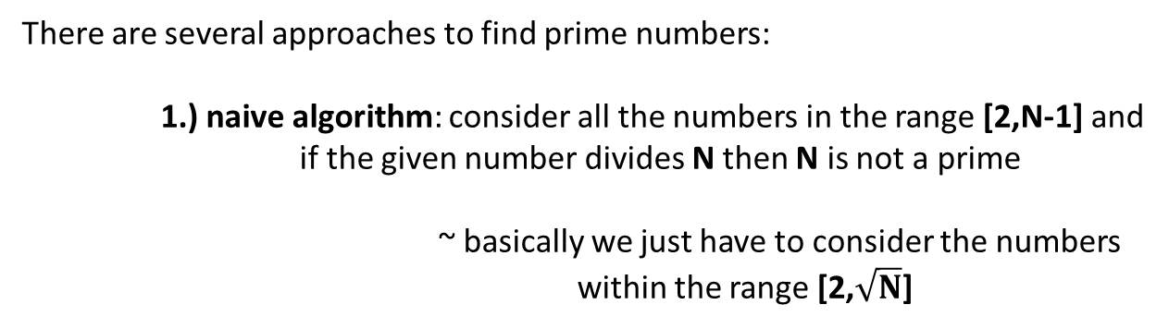
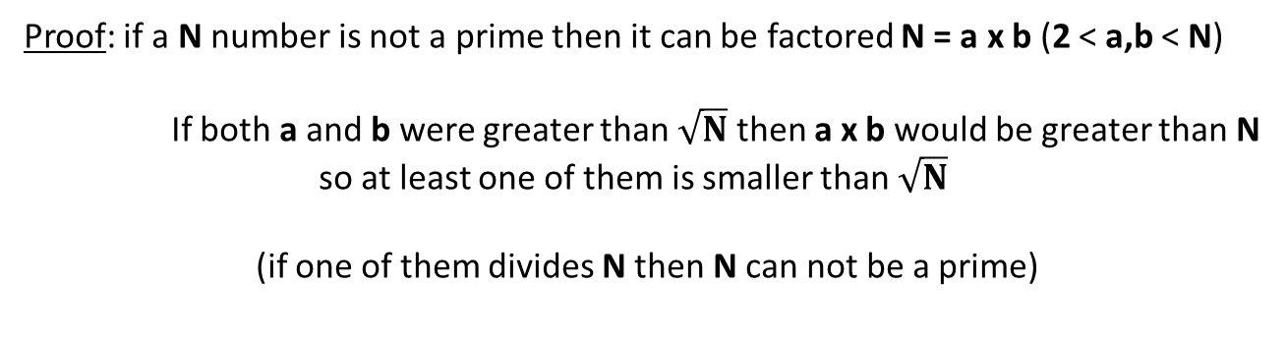
Modular Arithmetic
FINDING PRIME NUMBERS
There are several approaches to find prime numbers:
1.) naive algorithm: consider all the numbers in the range [2,N-1] and
if the given number divides N then N is not a prime
~ basically we just have to consider the numbers
within the range [2,$\sqrt{N}$]
Every N composite number (so not primes) has a prime factor less than
or equal to its$\sqrt{N}$ square root
Proof: if a N number is not a prime then it can be factored N = a x b (2 < a,b < N)
If both a and b were greater than $\sqrt{N}$ then a x b would be greater than N
so at least one of them is smaller than $\sqrt{N}$
(if one of them divides N then N can not be a prime)

Slide 228
Modular Arithmetic
FINDING PRIME NUMBERS
There are several approaches to find prime numbers:
2.) Fermat’s algorithm: we can use Fermat’s little theorem to check
whether a given N number if prime or not
„number a is the witness
for compositeness of N”
N-1
a ≡ 1 (mod N)
If this relation is true than we know that N is a prime
In other words: if N is a prime number then for every 1 <= a < N number
a ≡ 1 (mod N) which means in programming that a % N = 1
N-1
N-1
4
For example: since 5 is prime thats why 2 % 5 = 1 so 5 is prime
Running time complexity: O(k log n)
3

Slide 229
Modular Arithmetic
FINDING PRIME NUMBERS
There are several approaches to find prime numbers:
2.) Fermat’s algorithm: we can use Fermat’s little theorem to check
whether a given N number if prime or not
N-1
a ≡ 1 (mod N)
repeat k times:
generate a random number in the range [2,N-2]
if a % N = 1 then N is probably prime
this test fails with
Carmichael numbers
PROBLEM
N-1
if gcd(a,n) = 1 then
Fermat test is not valid
FERMAT’S ALGORITHM IS PROBABILISTIC !!!
~ the probability of producing incorrect results for composite numbers is
low and can be reduced by doing more k iterations

Slide 230
Modular Arithmetic
FINDING PRIME NUMBERS
Running time complexity:
→ in other algorithms and data structures running time analysis the
size of the input is straightforward
Sorting: the input is the N numbers we want to sort and
the running time complexity is O(NlogN)
Shortest path: input is the N vertexes in the graph
→ now the input is a large number BUT we represent the numbers
in binary in computer science

Slide 231
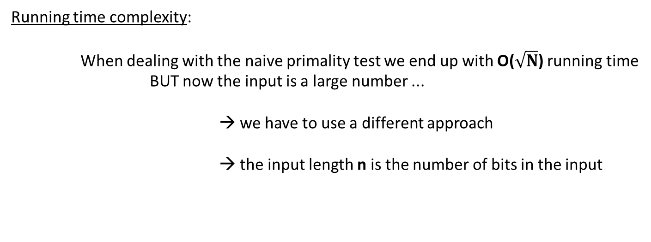
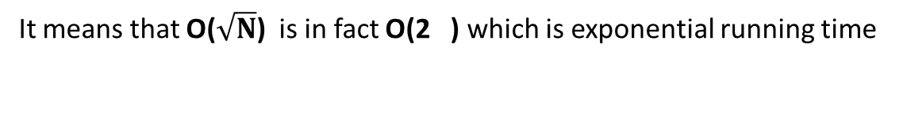

Modular Arithmetic
FINDING PRIME NUMBERS
Running time complexity:
When dealing with the naive primality test we end up with O($\sqrt{N}$) running time
BUT now the input is a large number ...
→ we have to use a different approach
→ the input length n is the number of bits in the input
So in our examples the input is a decimal number. So first of all we have to
define the number of bits of a decimal number
The input length in binary is n = log N
deciding whether a number is
prime is crucial in RSA so
exponential running
time is too slow
2
$$\frac{n}{2}$$
It means that O($\sqrt{N}$) is in fact O(2 ) which is exponential running time
~ of course it makes sense because the naive primality testing
algorithm is quite a slow approach

Slide 232
Modular Arithmetic
INTEGER FACTORIZATION
„Integer factorization is the decomposition of a composite number into
a product of smaller integers: usually we are interested in prime numbers”
THIS IS CALLED PRIME FACTORIZATION
Fundamental Theorem of Arithmetic
This theorem states that every positive integer can be written uniquely
as a product of prime numbers
For example: 210 = 2 x 3 x 5 x 7
prime factorization is a „trapdoor-function”
extremely easy to compute the result by multiplying the factors
but extremely hard to find the factors for large numbers

Slide 233
Modular Arithmetic
INTEGER FACTORIZATION
Trapdoor-functions are crucial in cryptography: the difficulty of factoring large integers
is the basis of some modern cryptographic algorithms (RSA)
→ SSL encryption used for TCP/IP connections relies on
the security of the RSA algorithm
→ if a fast approach is invented to factor large integers then
internet sites would no longer be secure

Slide 234
Modular Arithmetic
DISCRETE LOGARITHM PROBLEM
Calculating the discrete logarithm is another trapdoor-function
c
a ≡ b (mod m)
If we know b, c and m then this is called modular exponentiation
which is not that hard to solve
→ what is the inverse of this operation?
If we know a, b and m then this is called the discrete logarithm problem
which is a very difficult problem to solve

Slide 235
Modular Arithmetic
DISCRETE LOGARITHM PROBLEM
Calculating the discrete logarithm is another trapdoor-function
What is the running time complexity of modular exponentiation?
Modular exponentiation is relatively straightforward operation
~ have to use exponentiation with modulo operator
O(e) running time complexity
In this case e is the number of digits in the exponent !!!
What is the running time complexity of discrete logarithm problem?
Finding the right exponent for the discrete logarithm problem is
extremely hard: it has exponential running time complexity

Slide 236
Public Key Cryptography
„A cryptosystem should be secure even if everything
about the system except the key is public knowledge”
→ this is called the Kerckhoff’s principle
→ it is the fundamental principle of crytography
This is why we like prime numbers:
If we have two prime numbers p and q then multiplying them is quite easy M = p x q
but calculating the factors if we have M is extremely hard
~ this is called integer factorization
Public key cryptosystem: integer factorization is a good „trapdoor-function” which means it is
easy to verify (we just have to multiply the numbers) but calculating the
factors is almost impossible (without quantum computers)

Slide 237
Public Key Cryptography
Why is it important to use prime numbers at all?
factoring large numbers is usually hard: but not always
if a given number has smaller factors then it may happen that the factors can be found
within hundreds or thousands of iterations
So somehow we have to make sure the prime factors will be large ...
This is where prime numbers have been proved to be important: if we have p and q large prime numbers
then we can calculate N = p*q quite fast
What are the factors of N? Of course the factors are p and q and we know
that these are large primes (this is exactly why we chose them)
THE REASON WHY WE USE PRIME NUMBERS IS TO MAKE SURE FACTORIZATION IS PRACTICALLY IMPOSSIBLE

Slide 238
Diffie-Hellman Key Exchange
The main disadvantage of private key cryptosystems (DES or AES) is that
the private key must be exchanged
→ Diffie-Hellman algorithm is able to exchange private keys
over a public channel
→ it was invented in 1976 by Diffie, Hellman and Merkle
→ so this approach is not for encryption or decryption but to
securely exchange the private keys for symmetric cryptosystems
WE ARE NOT SHARING INFORMATION DURING THE KEY EXCHANGE !!!
~ we can create private keys separately based on modular arithmetic

Slide 239
Diffie-Hellman Key Exchange
First we have to generate huge prime numbers n and g
There is a constraint: g must be the primitive root of n
2
n-1
Primitive root: g is the primitive root of n if g mod n , g mod n ... g mod n generates
all the integers within the range [1,n-1]
For example: n=11 and g=8
1
8 mod 11 = 8
2
8 mod 11 = 9
3
8 mod 11 = 6
4
8 mod 11 = 4
we can come to the conclusion that 8 is
a primitive root of 11 so these are good values
for Diffie-Hellman key exchange algorithm
5
8 mod 11 = 10
6
8 mod 11 = 3
7
8 mod 11 = 2
8
8 mod 11 = 5
9
8 mod 11 = 7
10
8 mod 11 = 1

Slide 240
Diffie-Hellman Key Exchange
First we have to generate huge prime numbers n and g
There is a constraint: g must be the primitive root of n
2
n-1
Primitive root: g is the primitive root of n if g mod n , g mod n ... g mod n generates
all the integers within the range [1,n-1]
For example: n=11 and g=10
1
10 mod 11 = 10
2
10 mod 11 = 1
3
10 mod 11 = 10
4
10 mod 11 = 1
we can come to the conclusion that 10 is NOT
a primitive root of 11 so these are NOT good values
for Diffie-Hellman key exchange algorithm
5
10 mod 11 = 10
6
10 mod 11 = 1
7
10 mod 11 = 10
8
10 mod 11 = 1
9
10 mod 11 = 10
10
10 mod 11 = 1

Slide 241
Diffie-Hellman Key Exchange
The Diffie-Hellman Cryptosystem:
1.) the sender (Alice) generates huge prime numbers n and g (the primitive root of n) and sends it
to the receiver (Bob) (it is not a problem if someone knows these numbers)
These numbers are tipically > 1024 bits !!!
2.) both the sender and the receiver generate a random number < n-1
Alice generates x and Bob generates y (these are the private keys)
3.) Alice calculates k = g mod n and send it to Bob and Bob calculates k = g mod n and sends it to Alice
4.) they can calculate the shared secret key:
Alice calculates: k mod n = (g mod n) mod n = g mod n
Bob calculates: k mod n = (g mod n) mod n = g mod n
x
y
1
2
x
y
x
xy
2
we can use this value as a
private key in symmetric cryptosystems
y
x
y
yx
1

Slide 242
Diffie-Hellman Key Exchange
SENDER RECEIVER
Prime number n=37 and g=13
x = 23 (random number the private key)
y = 14 (random number the private key)
x
23
y
14
k = g mod n = 13 mod 37 = 2
k = g mod n = 13 mod 37 = 25
1
2
Alice send k to Bob
1
Bob send k to Alice
2
x
23
y
14
k mod n = 25 mod 37 = 30
k mod n = 2 mod 37 = 30
2
1
It means that for example Alice can use 30 for AES encryption,
Bob can use 30 for AES decryption and it will work fine !!!

Slide 243
Diffie-Hellman Key Exchange
Why is it important to choose a primitive root?
The size of the keyspace is crucial in cryptography: if there are just a few keys
we can check them even with brute-force search quite fast
→ so somehow we have to make sure the size of the
keyspace is as large as possible
→ if we use n=11 and g=10 values then there would be just 2 possible keys
→ how to make sure we have the maximum number of keys? If we use
the primitive root of n !!!
Another important factor is to use a large prime number for n: of course because the size of
the keyspace is proportinal to the value of n
~ the valid keys will be within the range [1,n-1] and if we use the primitive root
then all the integer values within this range are valid possible keys

Slide 244
Diffie-Hellman Key Exchange
Why is it important to choose n to be prime?
if n is not a prime it is easier to crack Diffie-Hellman cryptosystem
the whole cryptosystem relies heavily on the fact that solving the discrete
logarithm problem has exponential running time complexity so it is extremely hard
If we use composite numbers for n then solving the discrete logarithm
problem (so cracking the cryptosystem) is easier because
of the Chinese Remainder Theorem

Slide 245
Cracking Diffie-Hellman Key Exchange
The Diffie-Hellman cryptosystem relies on the fact that there is no efficient and
fast algorithm to calculate the discrete logarithm
x
23
y
14
k = g mod n = 13 mod 37 = 2
k = g mod n = 13 mod 37 = 25
1
2
Alice sends k to Bob
1
Bob sends k to Alice
2
The attacker may know n, g, k and k because these parameters are being sent
over a public channel (for example the internet)
1
2
x
k = g mod n
in theory we can calculate the private keys x and y
but this is the discrete logarithm problem
~ there is no efficient algorithm
1
y
k = g mod n
2
DIFFIE-HELLMAN CRYPTOSYSTEM IS SECURE BECAUSE OF THE DISCRETE LOGARITHM PROBLEM !!!

Slide 246
Cracking Diffie-Hellman Key Exchange
The main problem with Diffie-Hellman key exchange algorithm is that
it does not provide any authentication
→ thats why attackers can use man-in-the-middle attack
→ cracking the Diffie-Hellman cryptosystem is practically impossible
because of the discrete logarithm problem
MAN IN THE MIDDLE ATTACK RELIES ON THE FACT THAT THERE IS NO
AUTHENTICATION DURING THE n, g, k and k PARAMETER EXCHANGE
→ it is not about cracking the cryptosystem directly !!!
1
2

Slide 247


Cracking Diffie-Hellman Key Exchange
Alice
Bob
Mallory

Slide 248
Cracking Diffie-Hellman Key Exchange
n=37 and g=13
Alice
Bob
x (random number < n-1)
x
k = g mod n
1
Mallory

Slide 249
Cracking Diffie-Hellman Key Exchange
n=37 and g=13
Alice
Bob
x (random number < n-1)
x
k = g mod n
Alice sends k to Bob but
Mallory is the man in the middle
1
1
Mallory has k
1
Mallory

Slide 250
Cracking Diffie-Hellman Key Exchange
n=37 and g=13
Alice
Bob
x (random number < n-1)
x
k = g mod n
1
z (random number < n-1)
z
Mallory has k
m = g mod n
1
1
Mallory

Slide 251
Cracking Diffie-Hellman Key Exchange
n=37 and g=13
Alice
Bob
x (random number < n-1)
instead of Alice’s k
Mallory sends m to Bob
1
x
k = g mod n
1
1
z (random number < n-1)
z
Mallory has k
m = g mod n
1
1
Mallory

Slide 252
Cracking Diffie-Hellman Key Exchange
n=37 and g=13
Alice
Bob
x (random number < n-1)
y (random number < n-1)
x
y
k = g mod n
k = g mod n
1
2
y
m mod n
1
Bob thinks it is the shared
secret key with Alice but in
fact it is the shared secret key
with Mallory !!!
z (random number < n-1)
z
Mallory has k
m = g mod n
1
1
Mallory

Slide 253
Cracking Diffie-Hellman Key Exchange
n=37 and g=13
Alice
Bob
x (random number < n-1)
y (random number < n-1)
Bob send k to Alice but
Mallory is the man in the middle
x
2
y
k = g mod n
k = g mod n
1
2
y
m mod n
1
Bob thinks it is the shared
secret key with Alice but in
fact it is the shared secret key
with Mallory !!!
z (random number < n-1)
z
Mallory has k
and k
m = g mod n
1
1
2
Mallory

Slide 254
Cracking Diffie-Hellman Key Exchange
n=37 and g=13
Alice
Bob
x (random number < n-1)
y (random number < n-1)
x
y
k = g mod n
k = g mod n
1
2
y
m mod n
1
Bob thinks it is the shared
secret key with Alice but in
fact it is the shared secret key
with Mallory !!!
z (random number < n-1)
z
Mallory has k
and k
m = g mod n
1
1
2
w (random number < n-1)
Mallory
w
m = g mod n
2

Slide 255
Cracking Diffie-Hellman Key Exchange
n=37 and g=13
Alice
Bob
x (random number < n-1)
y (random number < n-1)
x
y
k = g mod n
k = g mod n
1
Mallory sends m to Alice
in the name of Bob
2
2
y
m mod n
1
Bob thinks it is the shared
secret key with Alice but in
fact it is the shared secret key
with Mallory !!!
z (random number < n-1)
z
Mallory has k
and k
m = g mod n
1
1
2
w (random number < n-1)
Mallory
w
m = g mod n
2

Slide 256
Cracking Diffie-Hellman Key Exchange
n=37 and g=13
Alice
Bob
x (random number < n-1)
y (random number < n-1)
x
y
k = g mod n
k = g mod n
1
2
x
m mod n
y
2
m mod n
1
Alice thinks it is the shared
secret key with Bob but in
fact it is the shared secret key
with Mallory !!!
Bob thinks it is the shared
secret key with Alice but in
fact it is the shared secret key
with Mallory !!!
z (random number < n-1)
z
Mallory has k
and k
m = g mod n
1
1
2
w (random number < n-1)
Mallory
w
m = g mod n
2

Slide 257
Cracking Diffie-Hellman Key Exchange
Alice
PROBLEM: Diffie-Hellman lacks authentication
so Alice and Bob have no idea about Mallory
Bob
SOLUTION: SHA256 hashes for authentication
zy
yz
wx
xw
g mod n = g mod n
g mod n = g mod n
Alice and Mallory will use
this shared secret key
during encryption and decryption
Bob and Mallory will use
this shared secret key
during encryption and decryption
Mallory

Slide 258
RSA Cryptosystem
it is a public key cryptosystem (so it has a private key and a public key)
it was constructed in 1977 by Rivest, Shamir and Adleman
every public key cryptosystem relies heavily on a trapdoor function
~ RSA is secure because of the integer factorization problem
Integer factorization is a trapdoor function: validating the result by multiplying
two numbers is quite easy but finding the factors is hard

Slide 259
RSA Cryptosystem
Let p be a prime number then for any integer a (a is not divisible by p) the number
a - 1 is an integer multiple of p.
p-1
p-1
a ≡ 1 (mod p)
„Fermat’s little theorem”
We can generalize this theorem with Euler’s Φ(n) function: this totient function counts the
positive integers up to a given integer n that are relative prime to n
Φ(n)
a ≡ 1 (mod p)
if n and a are relative primes
Relative prime: two integers a and b are said to be relative prime or coprime
if the only positive integer (factor) that divides both of them is 1
gcd(a,b)=1

Slide 260
RSA Cryptosystem
Φ(5) = 1,2,3,4 → so the value of the function is 4
Φ(8) = 1,3,5,7 → so the value of the function is 4
Φ(7) = 1,2,3,4,5,6 → so the value of the function is 6
A very important feature of Euler’s Φ(n) function is that it is
quite easy to calculate for prime numbers
Φ(prime) = prime-1
~ of course because a prime is comprime by definition with
all the smaller integers within the range [1,prime-1]
WE CAN USE THIS FEATURE IN THE RSA CRYPTOSYSTEM !!!

Slide 261
RSA Cryptosystem
RSA ALGORITHM
1.) generate 2 large prime numbers p and q
~ we can use Rabin-Miller algorithm to do so
2.) calculate n = p q so let’s multiply the prime numbers
Φ(n) = (p-1)(q-1)
3.) let’s calculate the public key e parameter
We can calculate e such that gcd(e,Φ(n))=1
~ so basically e and Φ(n) are relative primes
4.) let’s calculate the private key d parameter: let’s calculate the modular inverse of e
(this is why it is crucial that e and Φ(n) is coprime)
*
e and Φ(n) share no
other factor than 1
d e mod Φ(n) = 1
we have to solve this equation
to get the d parameter
*
PUBLIC KEY: (e,n) PRIVATE KEY: (d,n)

Slide 262
RSA Cryptosystem
RSA ALGORITHM
PUBLIC KEY: (e,n) PRIVATE KEY: (d,n)
first we have to transform the plaintext into blocks
where every block is smaller than n
as usual we use the public key for encryption and the
private key for decrytion
e
ciphertext_block = plaintext_block mod n
we can use ASCII table
to convert text into numbers
d
plaintext_block = ciphertext_block mod n

Slide 263
RSA Cryptosystem
RSA ALGORITHM EXAMPLE
1.) let’s generate large prime numbers: p=17 and q=23
2.) let’s calculate n =p q=17x23=391 so Φ(n)=(17-1)(23-1)=352
3.) we have to find an e number where gcd(e, Φ (n))=1 so e=21
4.) we have to find the modular inverse of e so d=285
Public key: (21,391) Private key: (285,391)
*
For example: we have the character a we want to encrypt. The ASCII representation of a is 97
e
21
Encryption → ciphertext_block = plaintext_block mod n = 97 mod 391 = 37
d
285
Decryption → plaintext_block = ciphertext_block mod n = 37 mod 391 = 97

Slide 264
RSA Cryptosystem
CRACKING RSA ALGORITHM
the attacker has the public key (e,n) pair
the aim of the attacker is to calculate the private key (d,n) pair
n is not a problem because it is public !!!
OK luckily RSA algorithm is public so the attacker takes a look
at the theoretical background and the implementation as well
d can be calculated if we know e and the Euler’s Φ(n) function
the attacker knows
e because it is part
of the public key
the attacker knows
n is the multiple of
two primes (p and q)
INTEGER FACTORIZATION
TRAPDOOR FUNCTION !!!

Slide 265
RSA Cryptosystem
CRACKING RSA ALGORITHM
factoring large numbers is usually hard: but not always
if a given number has smaller factors then it may happen that the factors can be found
within hundreds or thousands of iterations
So somehow we have to make sure the prime factors will be large ...
This is where prime numbers have been proved to be important: if we have p and q large prime numbers
then we can calculate n = p*q quite fast
What are the factors of n? Of course the factors are p and q and we know
that these are large primes (this is exactly why we chose them)
THE REASON WHY WE USE PRIME NUMBERS IS TO MAKE SURE FACTORIZATION IS PRACTICALLY IMPOSSIBLE

